Slide 1
Carp Biomass Results - Draft
Hayden Schilling
1/02/2023

Slide 2
Brief methods
Using all boat electrofishing data from major rivers (July 94 onwards)
Bin dates into sampling seasons (financial years ending June)
Use length-weight relationships and length frequency data to calculate % biomass of carp in each ‘shot/sample’
Mixed Effect regression model to specifically account for repeated sampling within days and sites – separate model for each river.
Generate predictions with confidence intervals for each year/river with data
Repeated above for all NSW MDB Boat Electrofishing Data

Slide 3
Preliminary Results
Likely to change slightly…
Key points:
Overall NSW MDB: most estimates 40 – 50 %
In major Rivers - most estimates are between 40 – 60% (with some lower in poorly fit models currently being updated)
Suggests smaller rivers may have lower proportions of carp biomass than large rivers

Slide 4
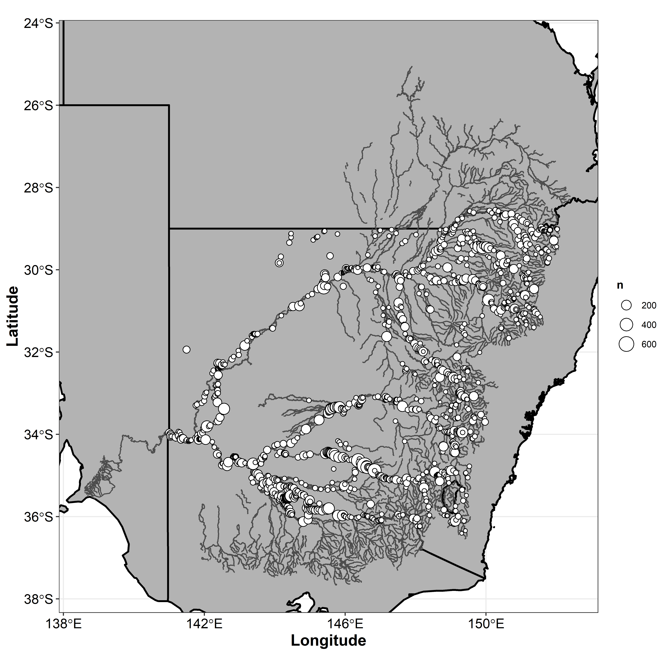
Overall Model
Fairly good spread of data but will be bias towards larger rivers as it’s all boat electrofishing data
See later plots for more detailed temporal data/effort at smaller scales

Slide 5
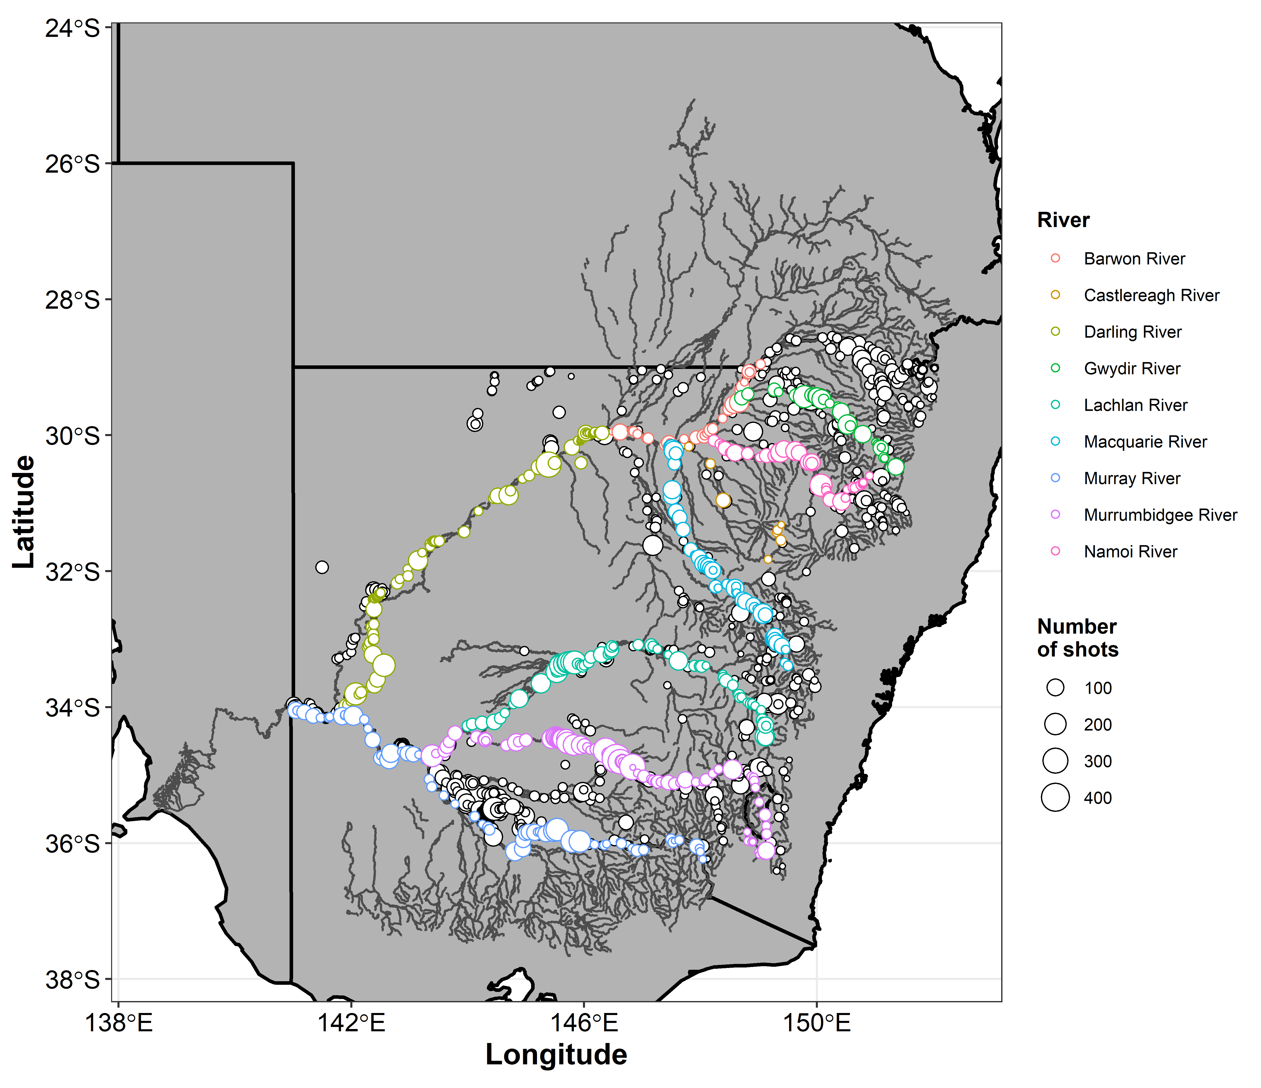

Slide 6
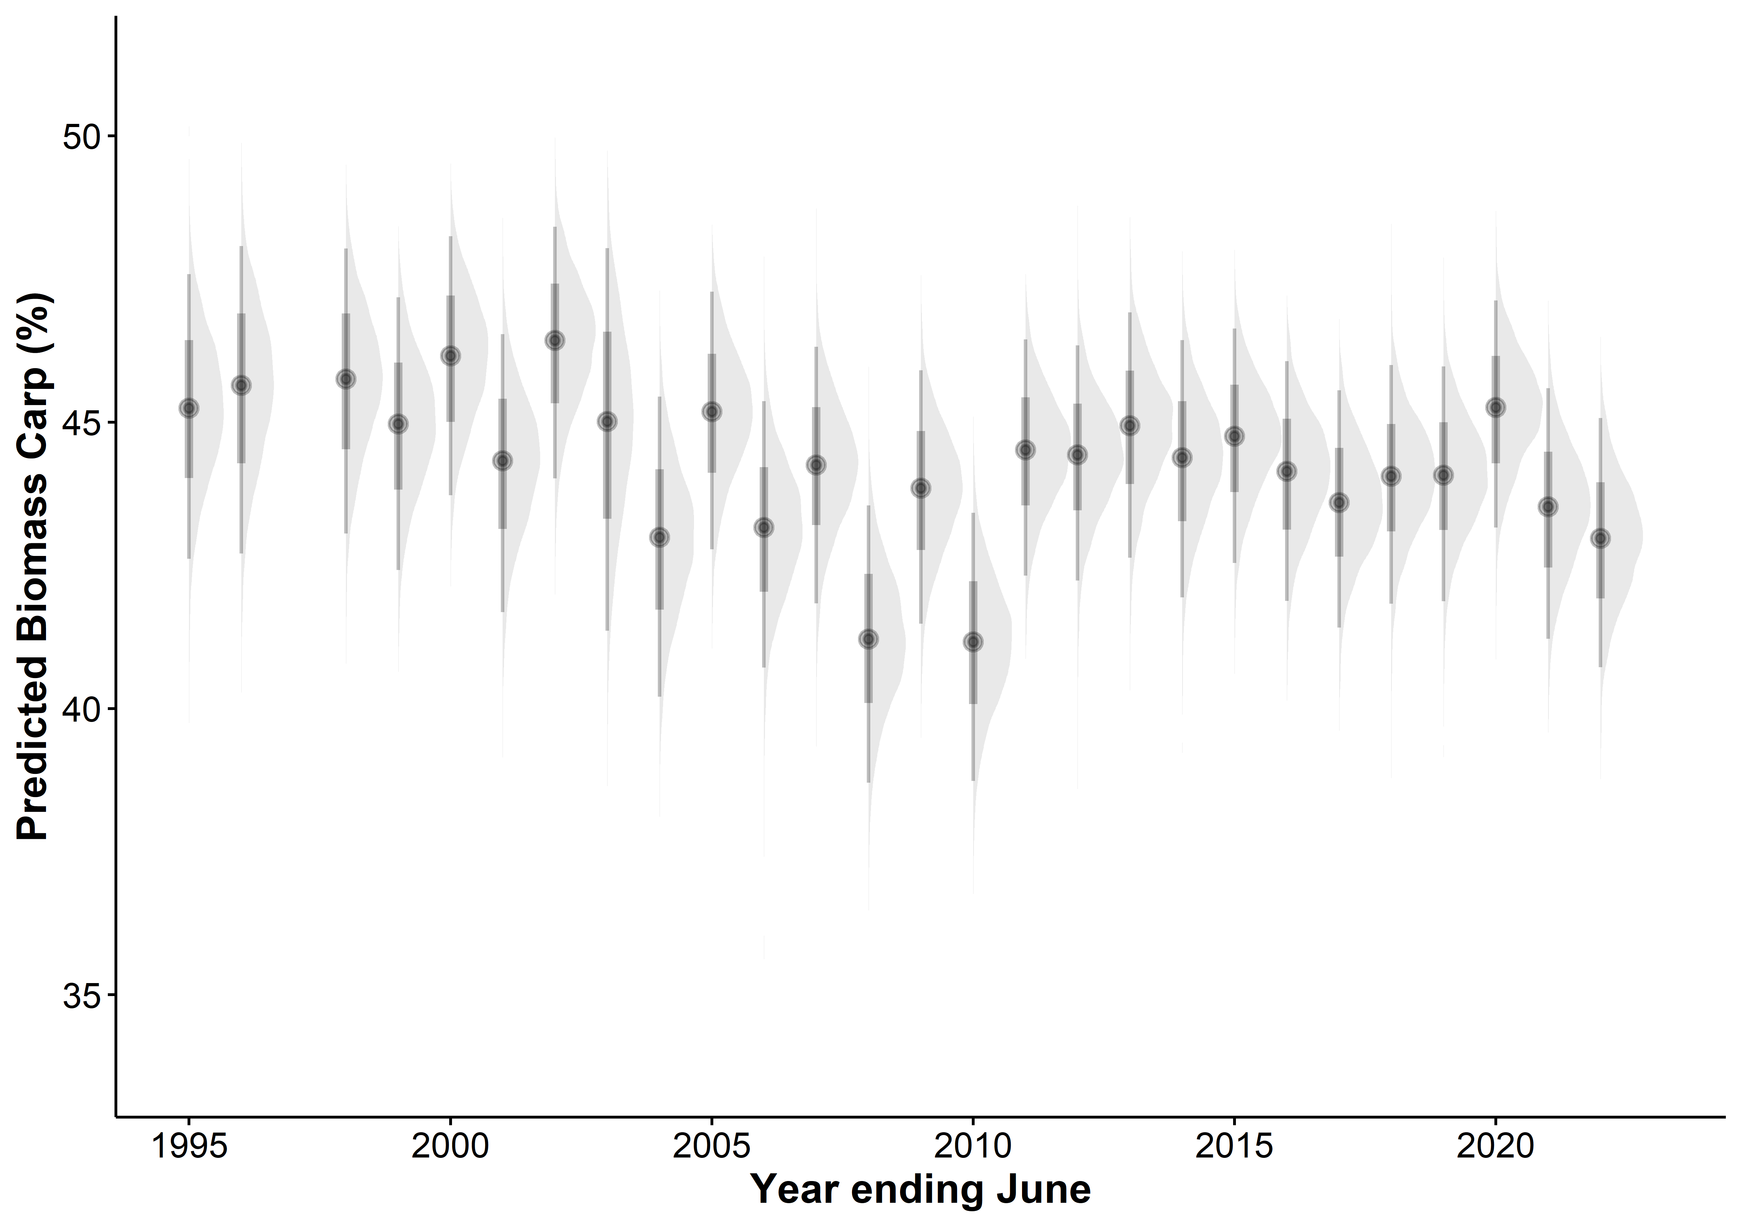
No sites >700m elevation ~ 3 % higher than all sites

Slide 7
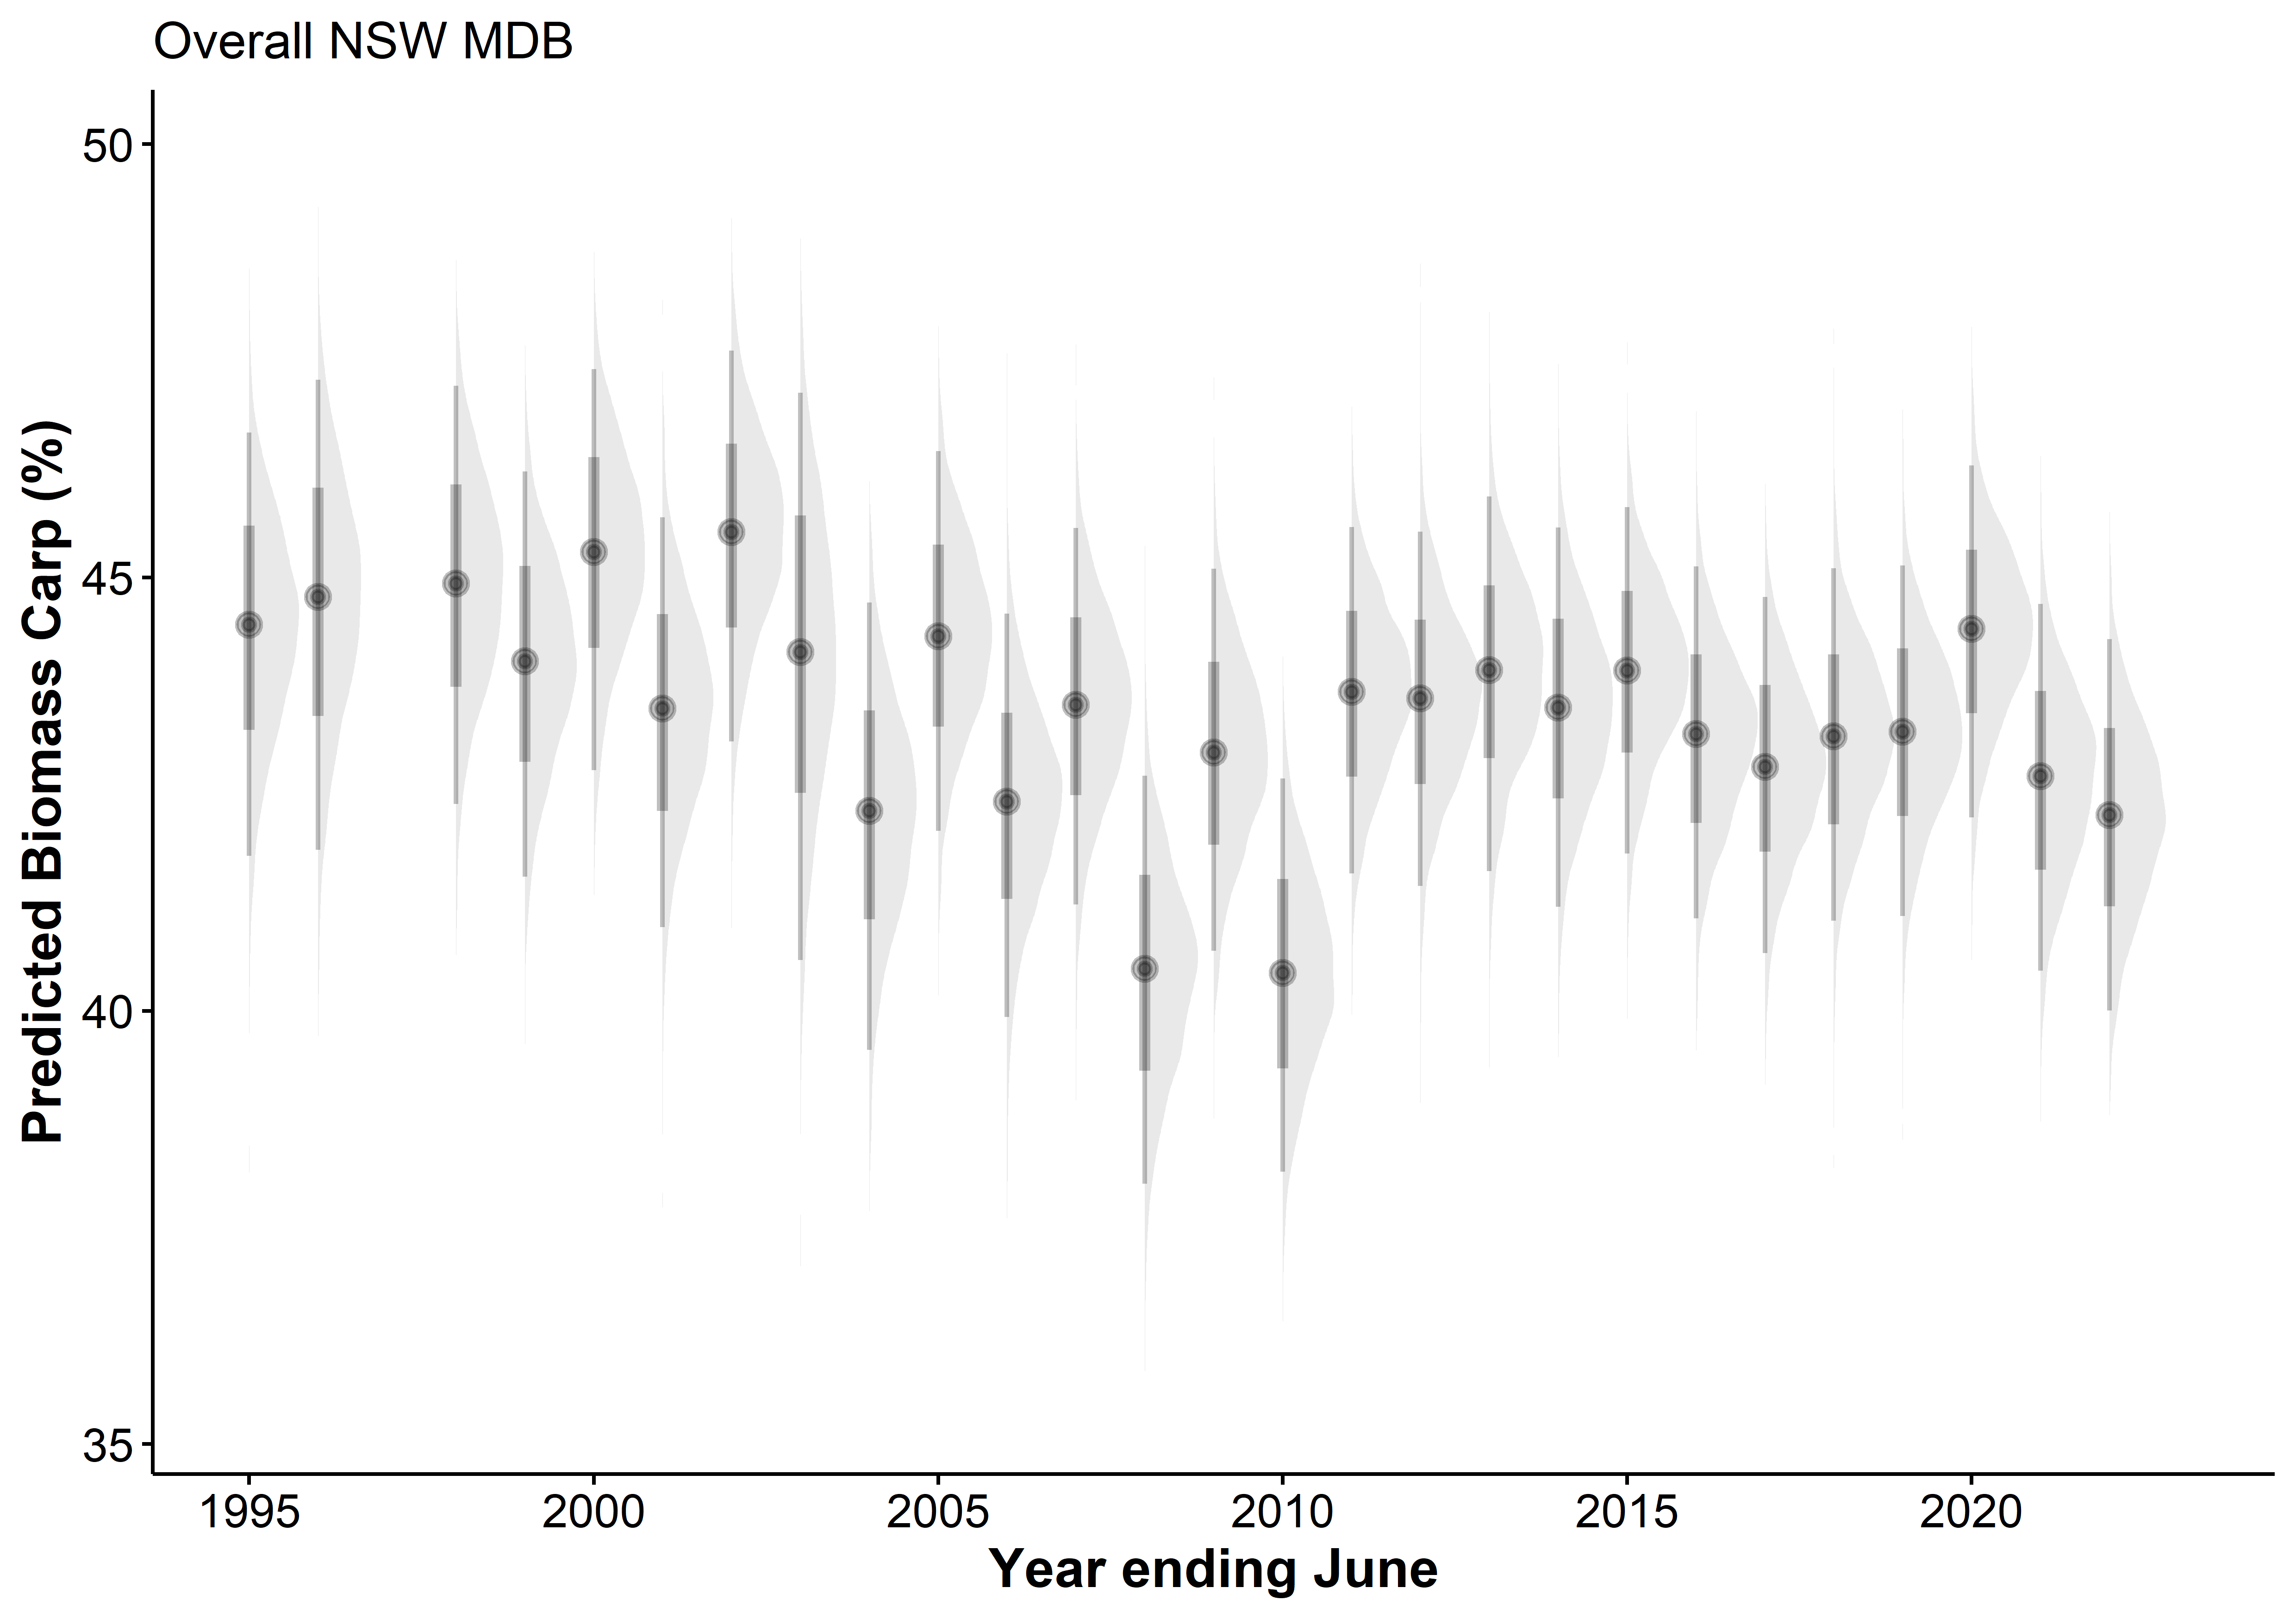
Model generally good but needs more iterations to better get confidence intervals
Points show the estimate, thick grey bars show 80% confidence, thin grey bars show 95% confidence

Slide 8
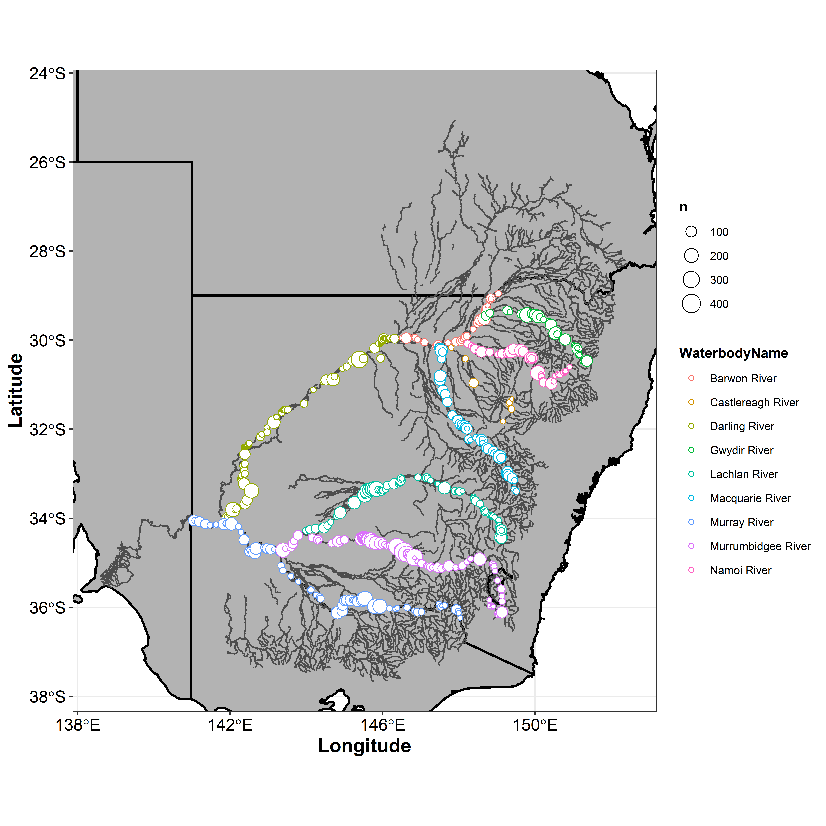
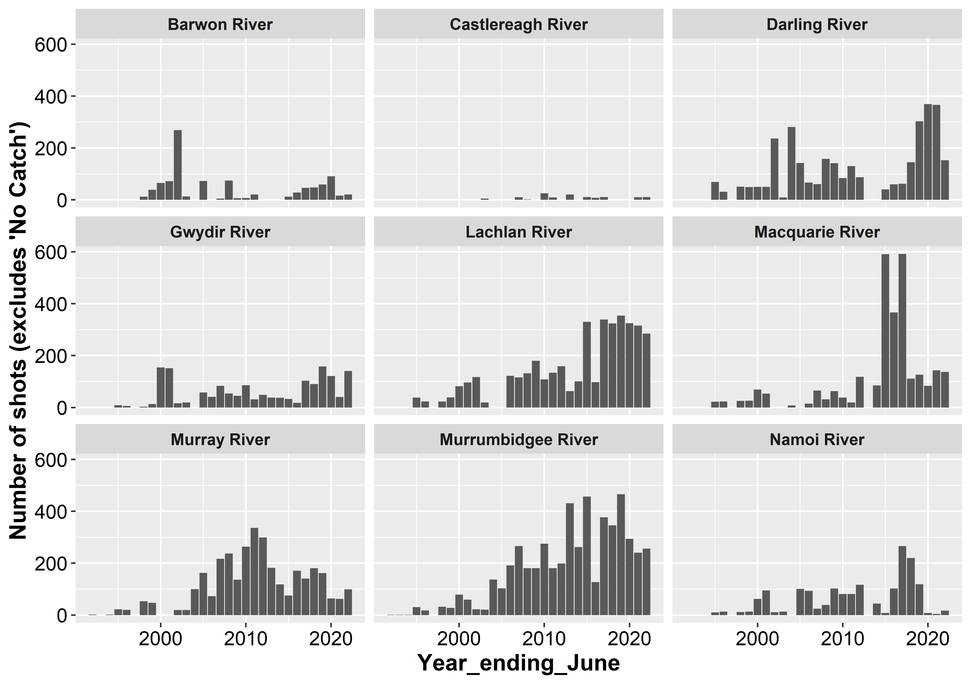
River specific models
Sample sizes for modelling

Slide 9
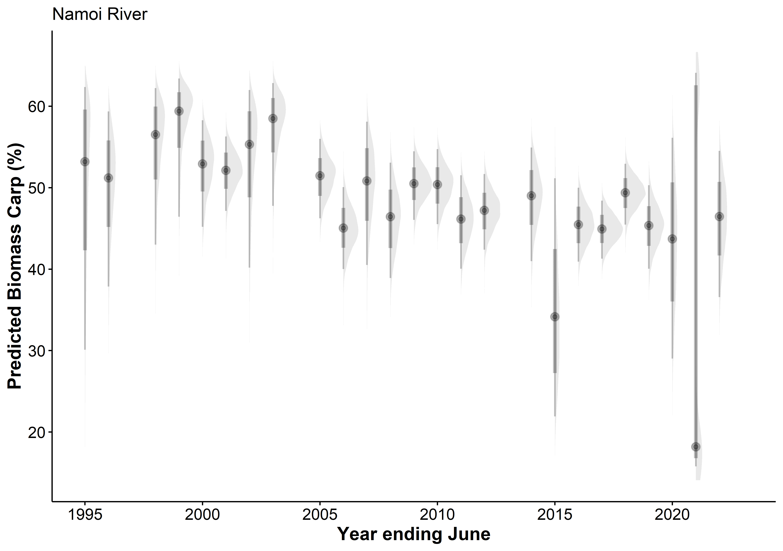
Good model fit
Points show the estimate, thick grey bars show 80% confidence, thin grey bars show 95% confidence

Slide 10
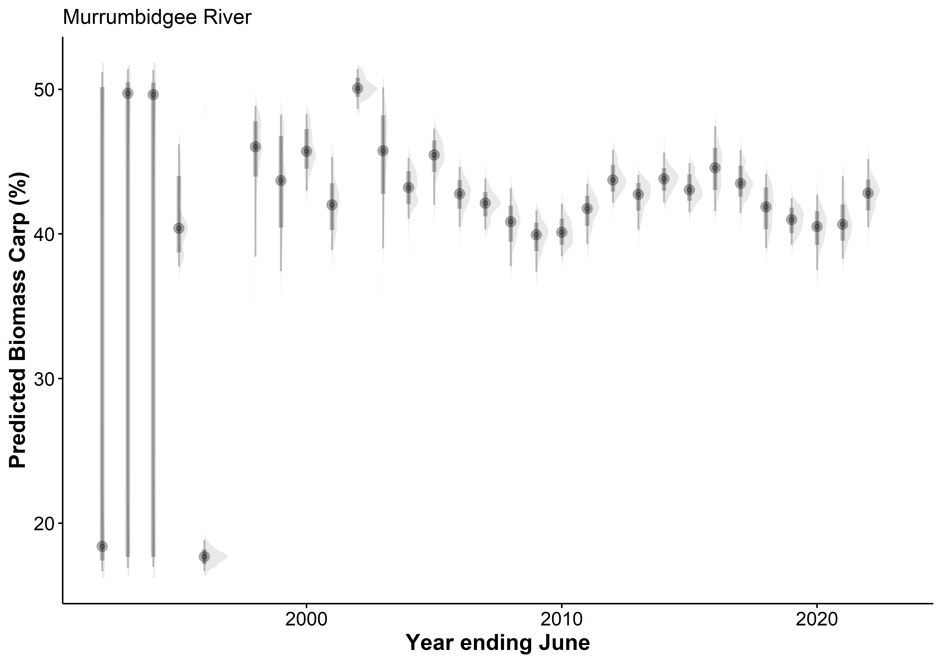
Poor model fit
- May need to remove 1st 3 years (92 – 94 where n=1)
Points show the estimate, thick grey bars show 80% confidence, thin grey bars show 95% confidence

Slide 11
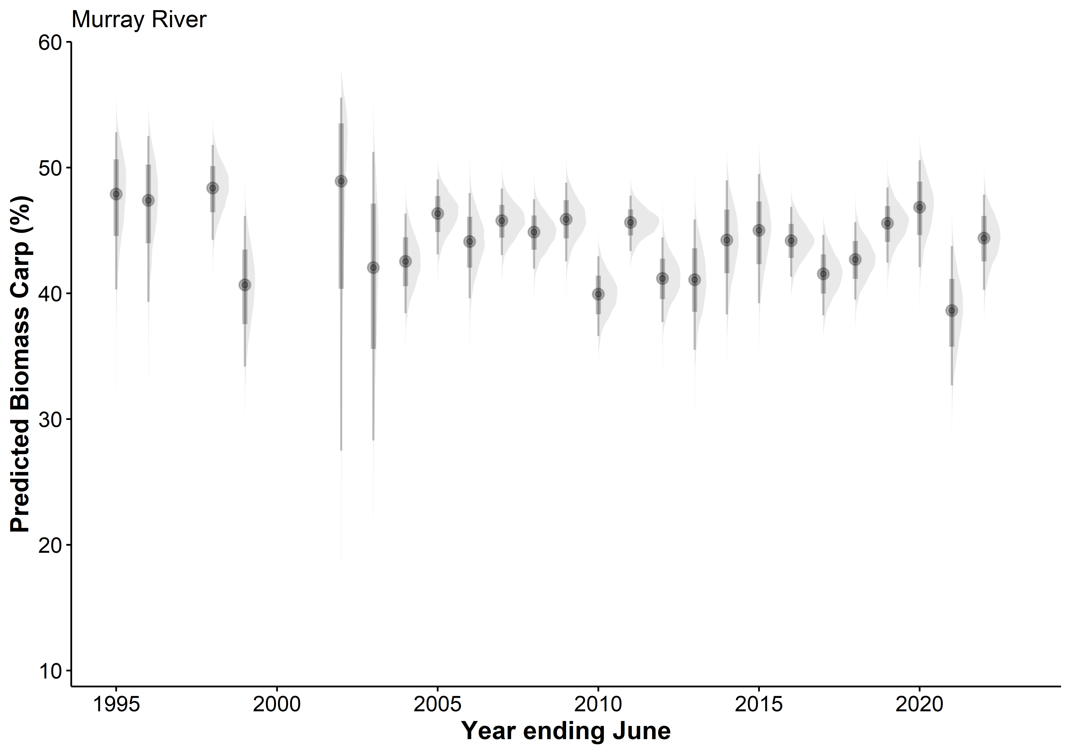
Good model fit
Points show the estimate, thick grey bars show 80% confidence, thin grey bars show 95% confidence

Slide 12
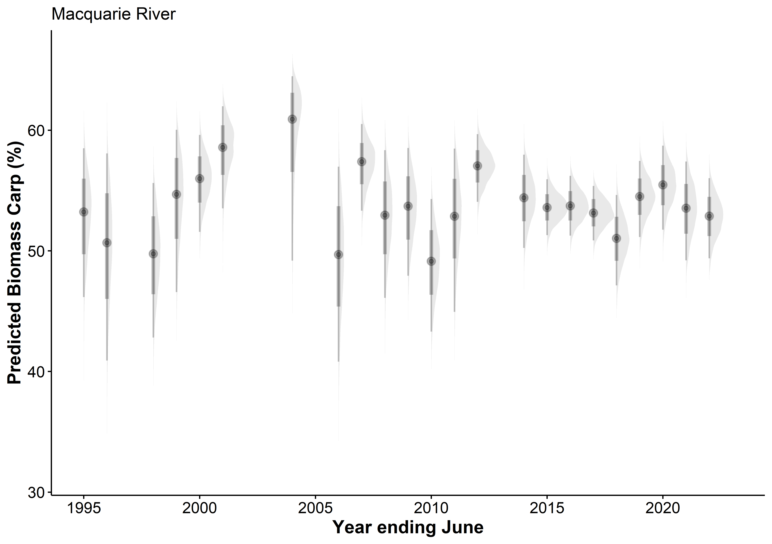
Good model fit
Points show the estimate, thick grey bars show 80% confidence, thin grey bars show 95% confidence

Slide 13
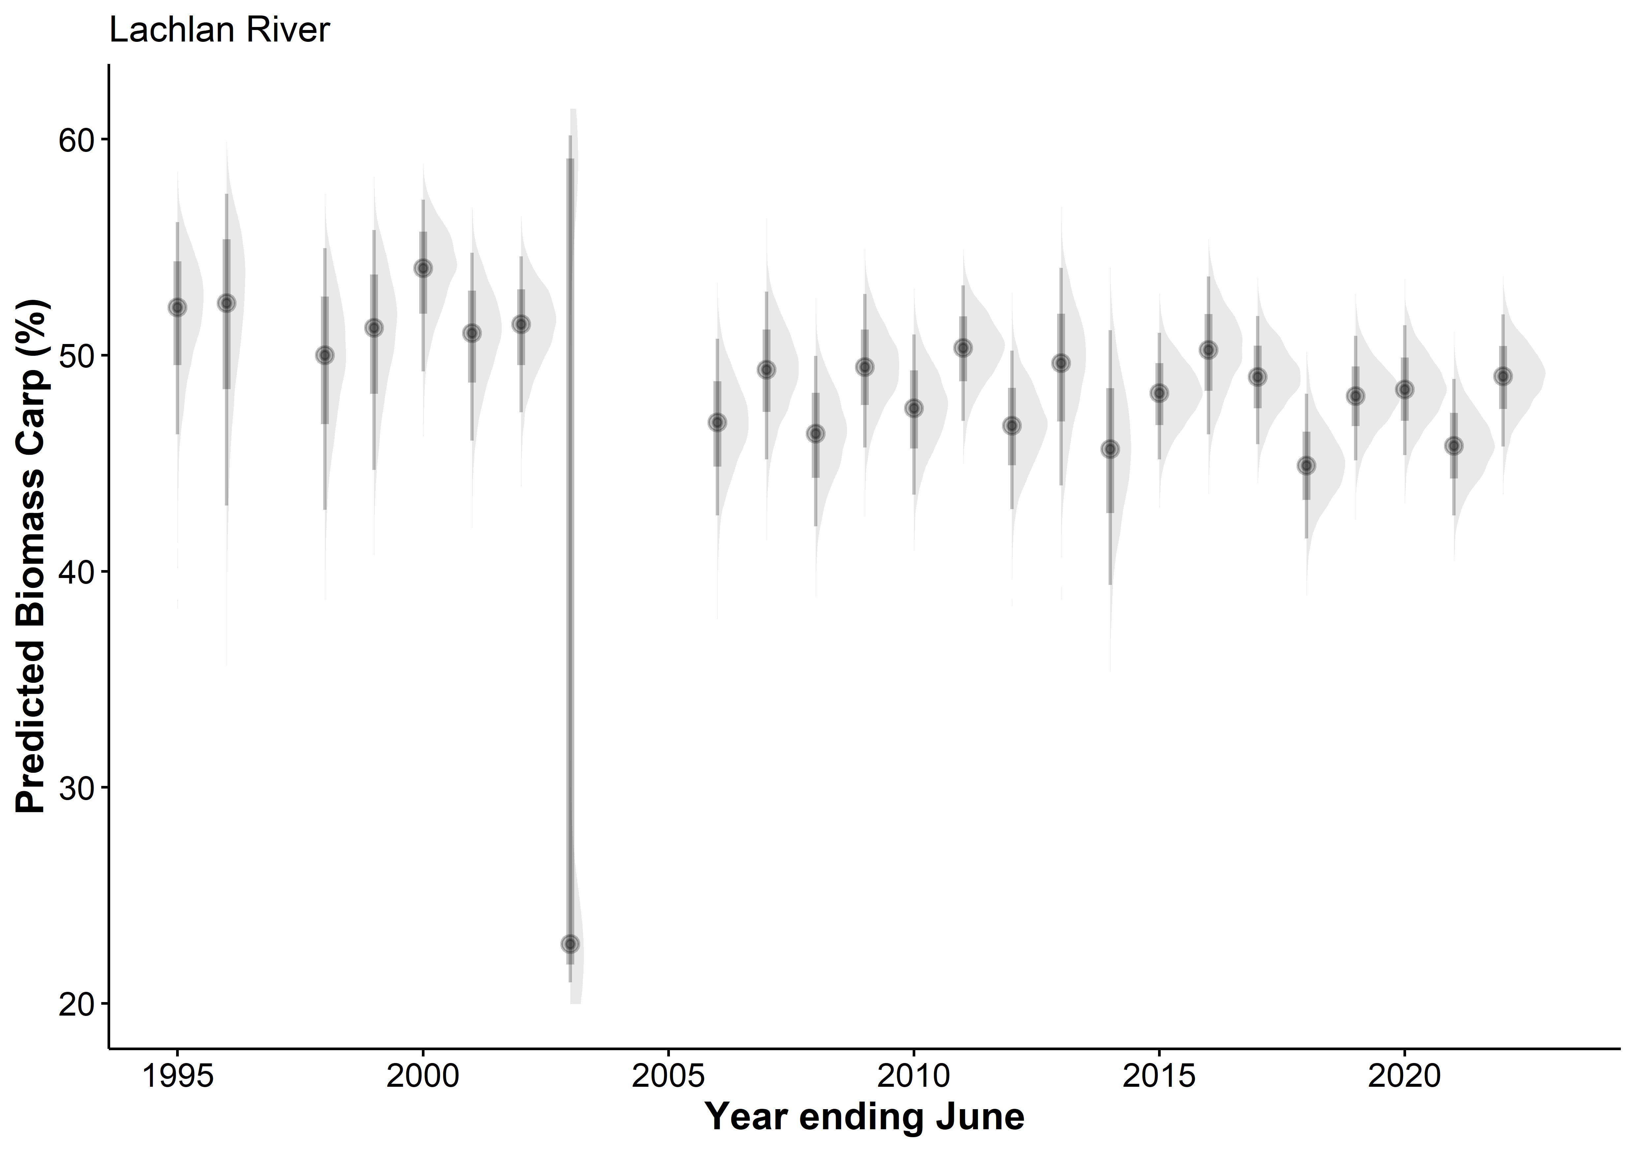
Good model fit
Points show the estimate, thick grey bars show 80% confidence, thin grey bars show 95% confidence

Slide 14
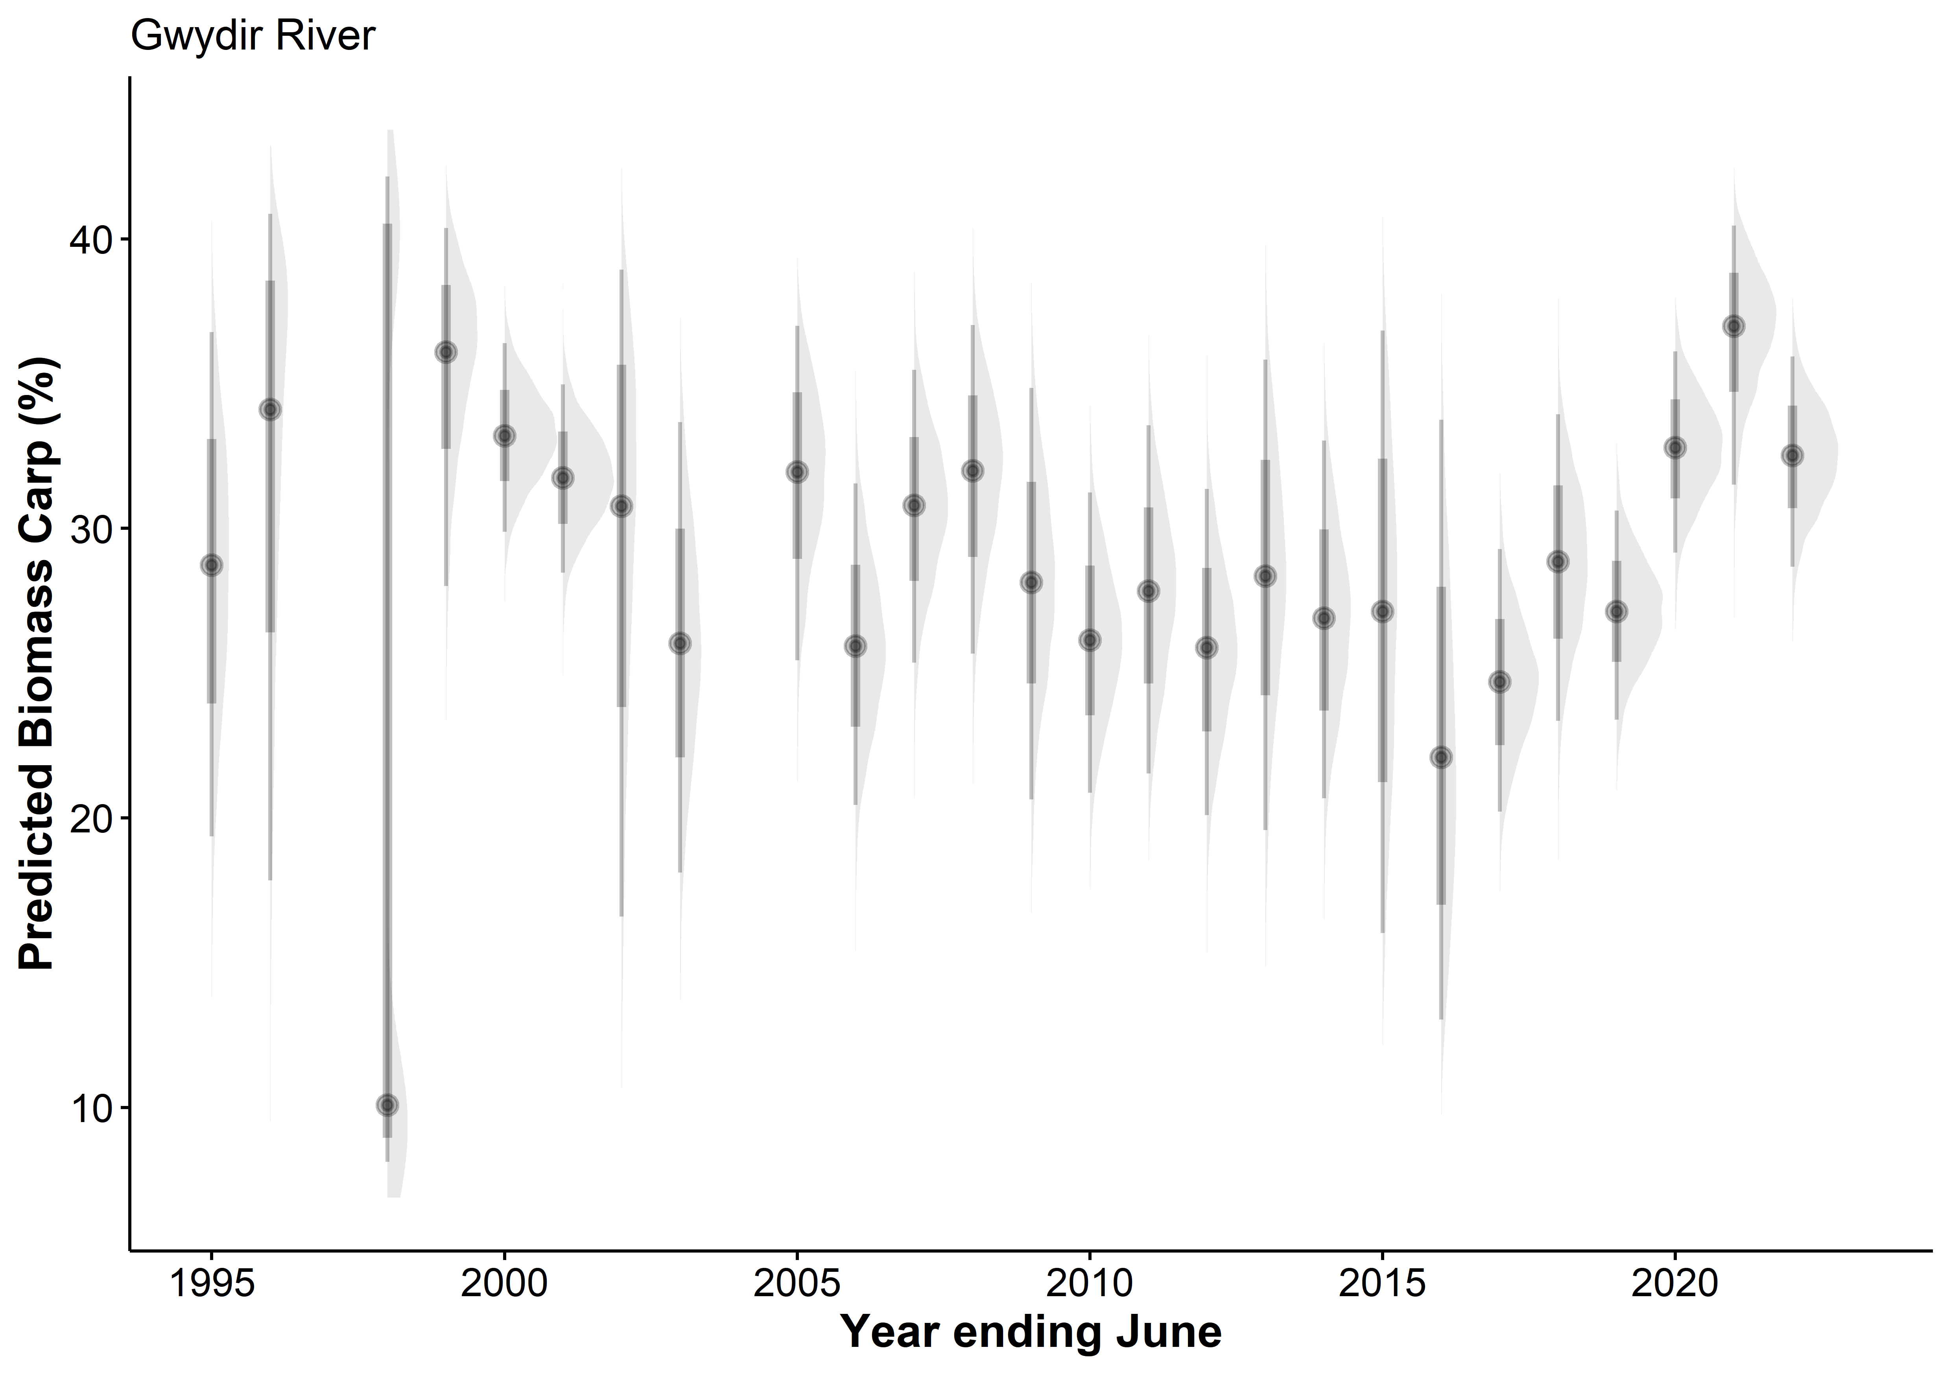
Good model fit
Points show the estimate, thick grey bars show 80% confidence, thin grey bars show 95% confidence

Slide 15
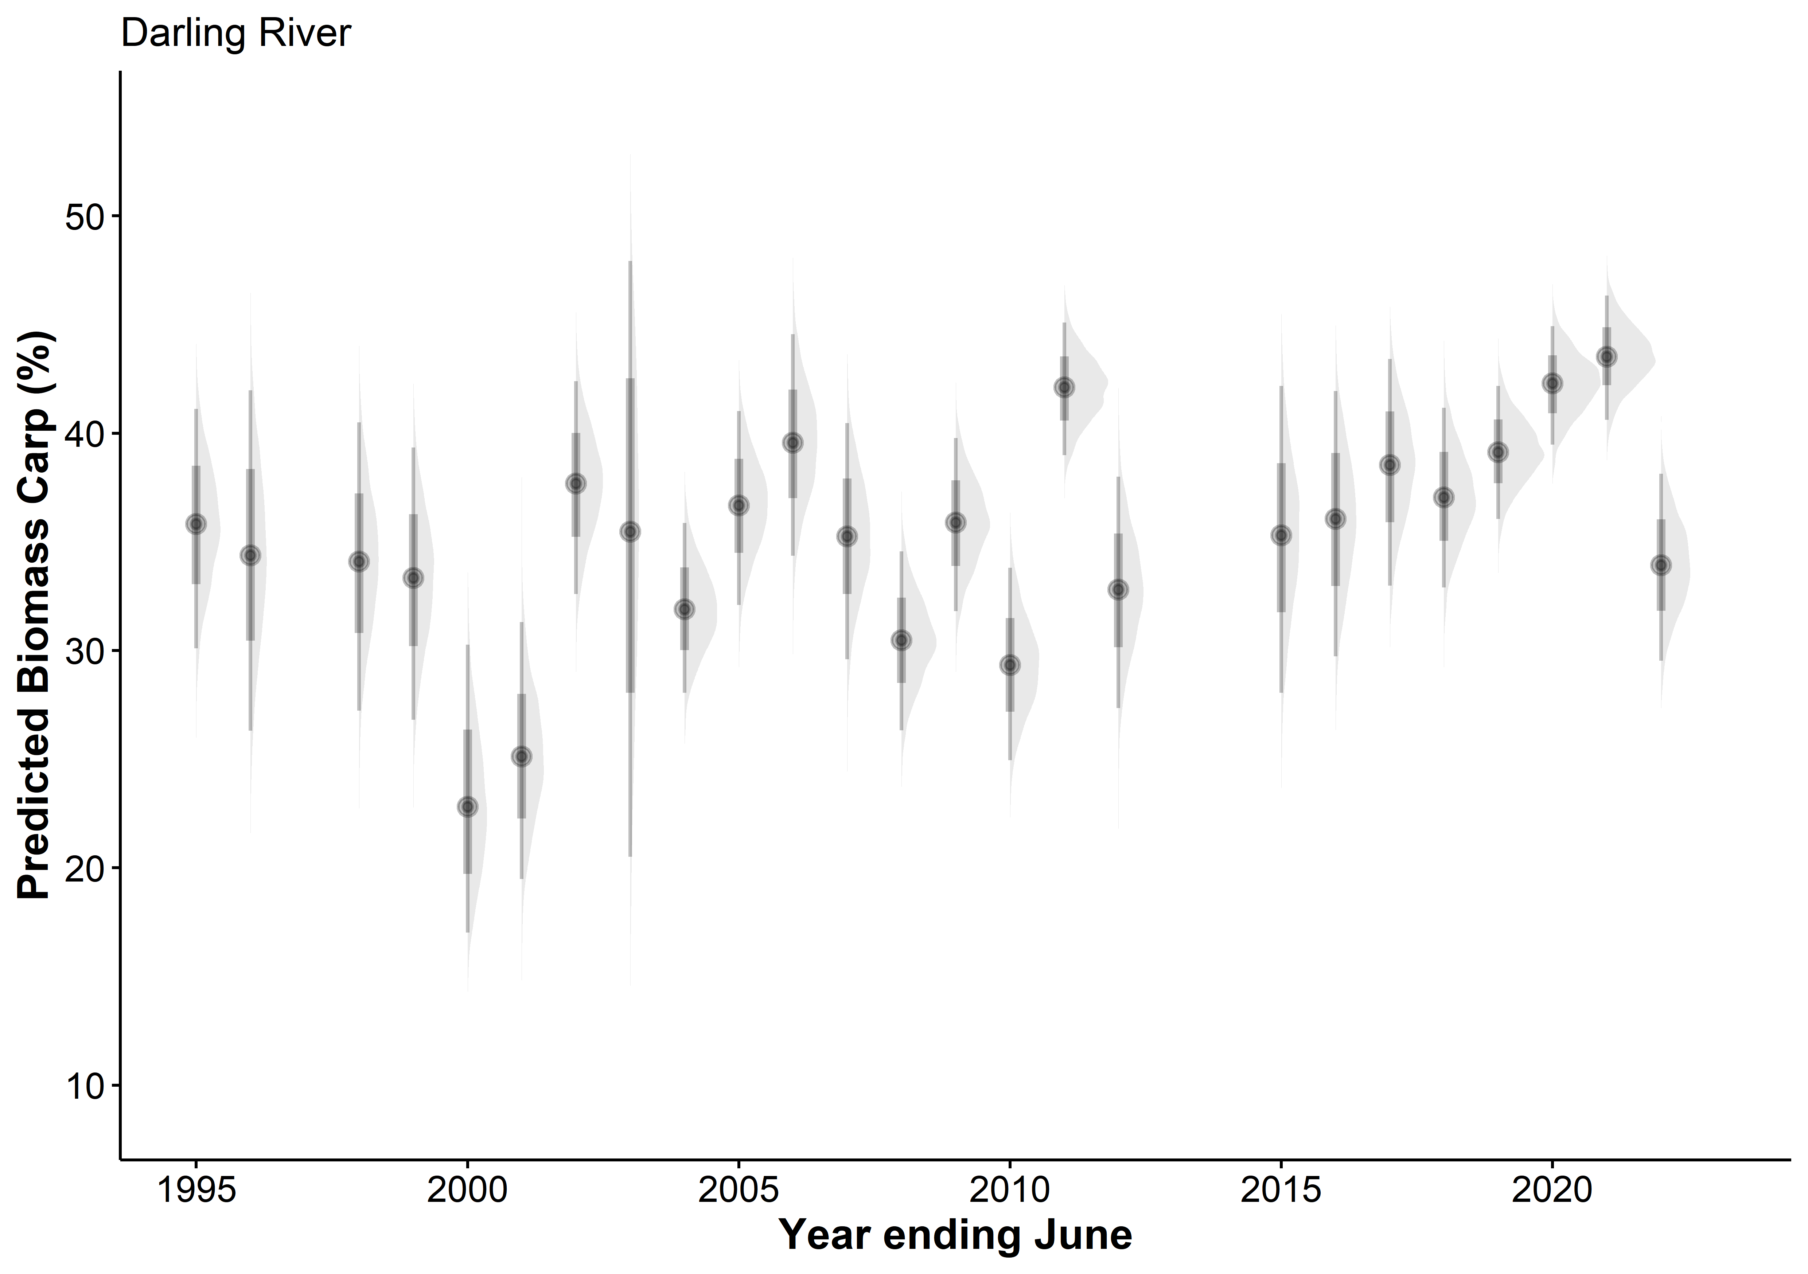
South of Bourke
Good model fit
Points show the estimate, thick grey bars show 80% confidence, thin grey bars show 95% confidence

Slide 16
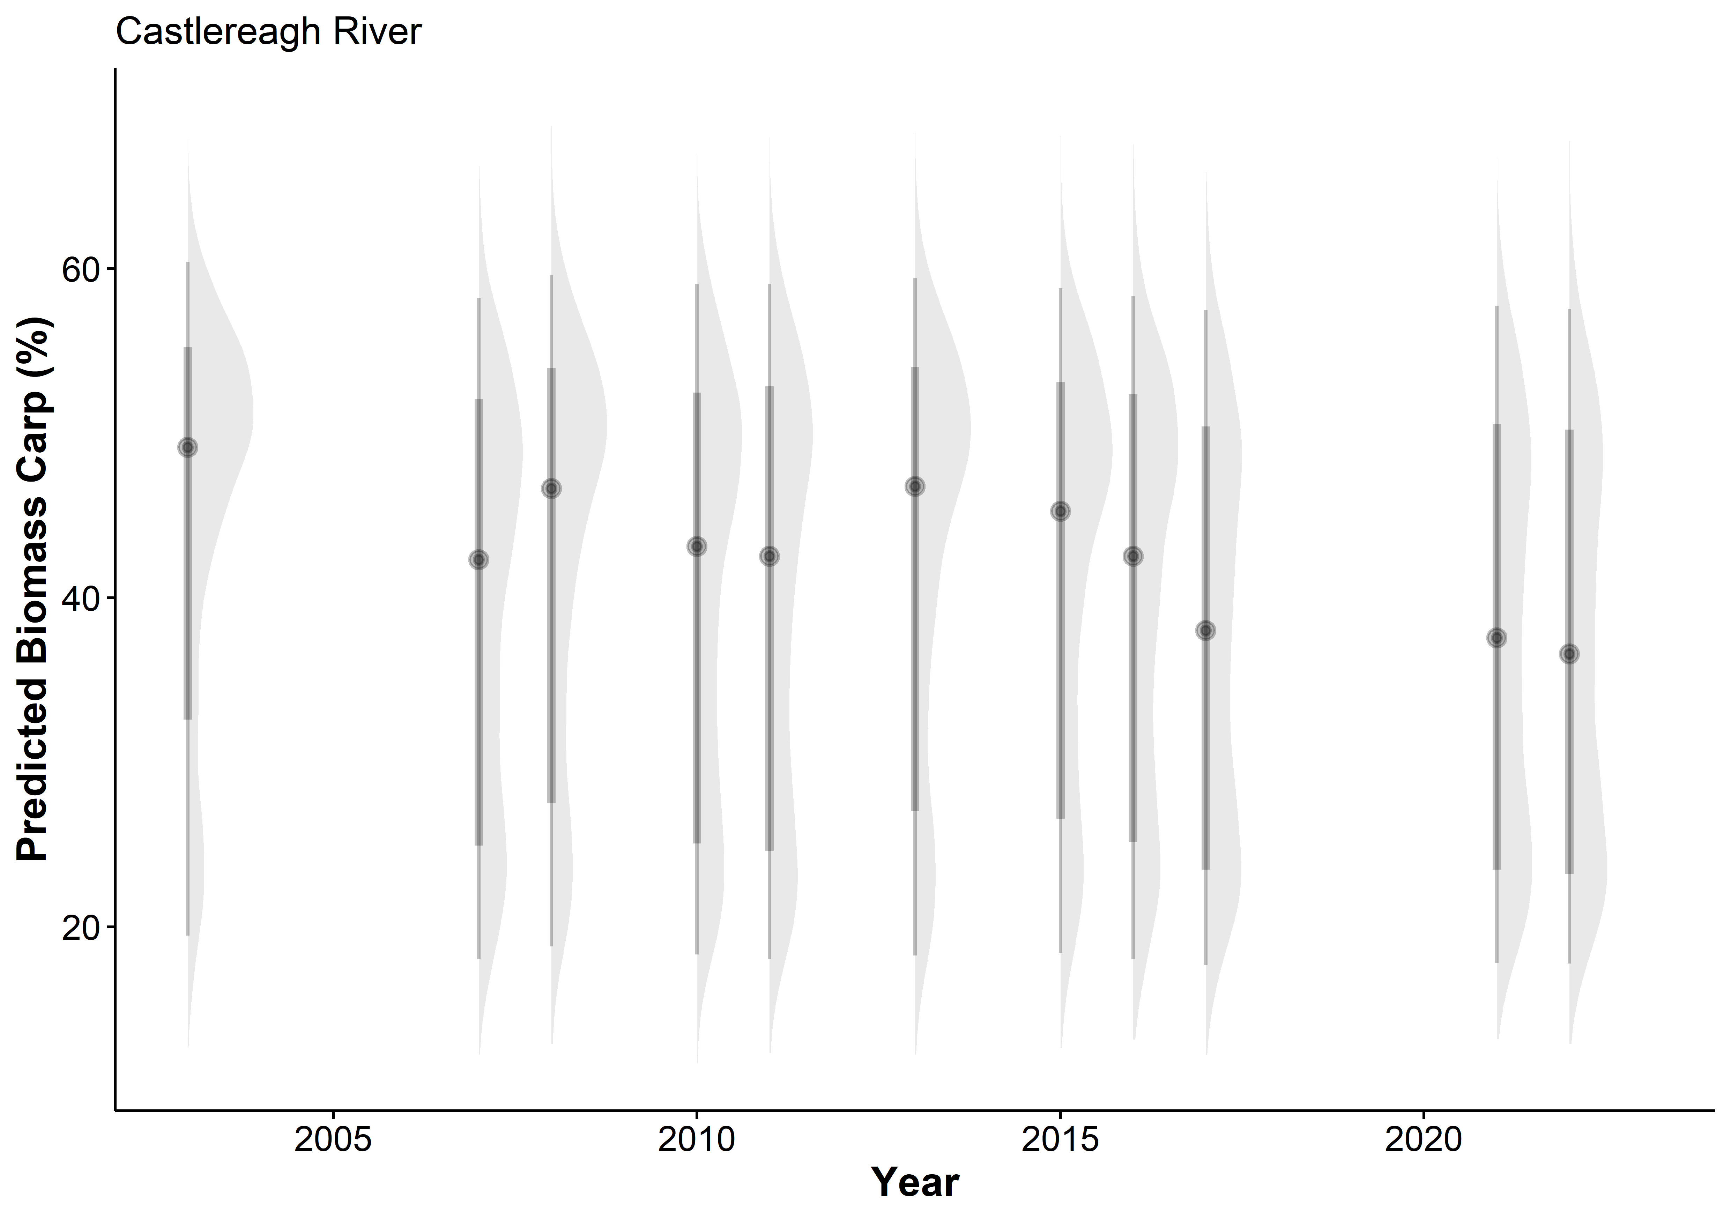
Good model fit
But few data points and not very informative (worth keeping?)
Points show the estimate, thick grey bars show 80% confidence, thin grey bars show 95% confidence

Slide 17
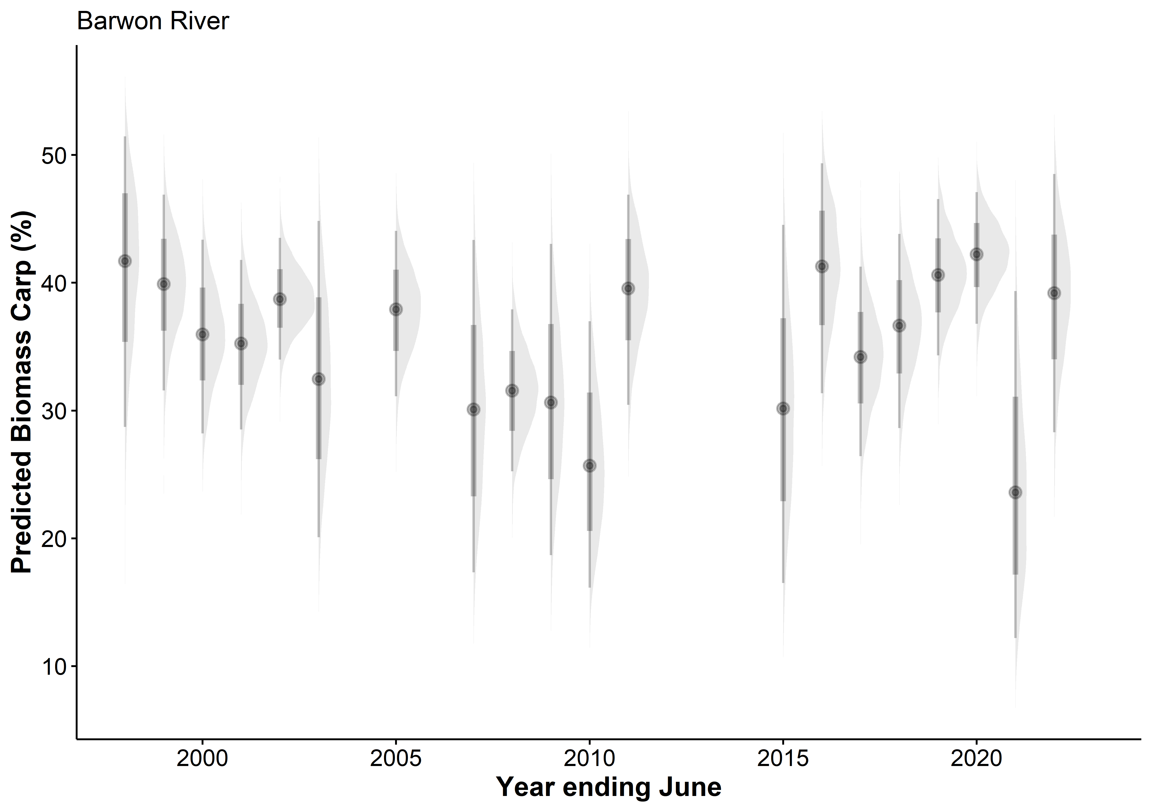
Good model fit
Points show the estimate, thick grey bars show 80% confidence, thin grey bars show 95% confidence

Slide 18
Raw data displays
The following slides show histograms of the raw data at the survey level (all shots in a SampleRecordID are pooled)

Slide 19
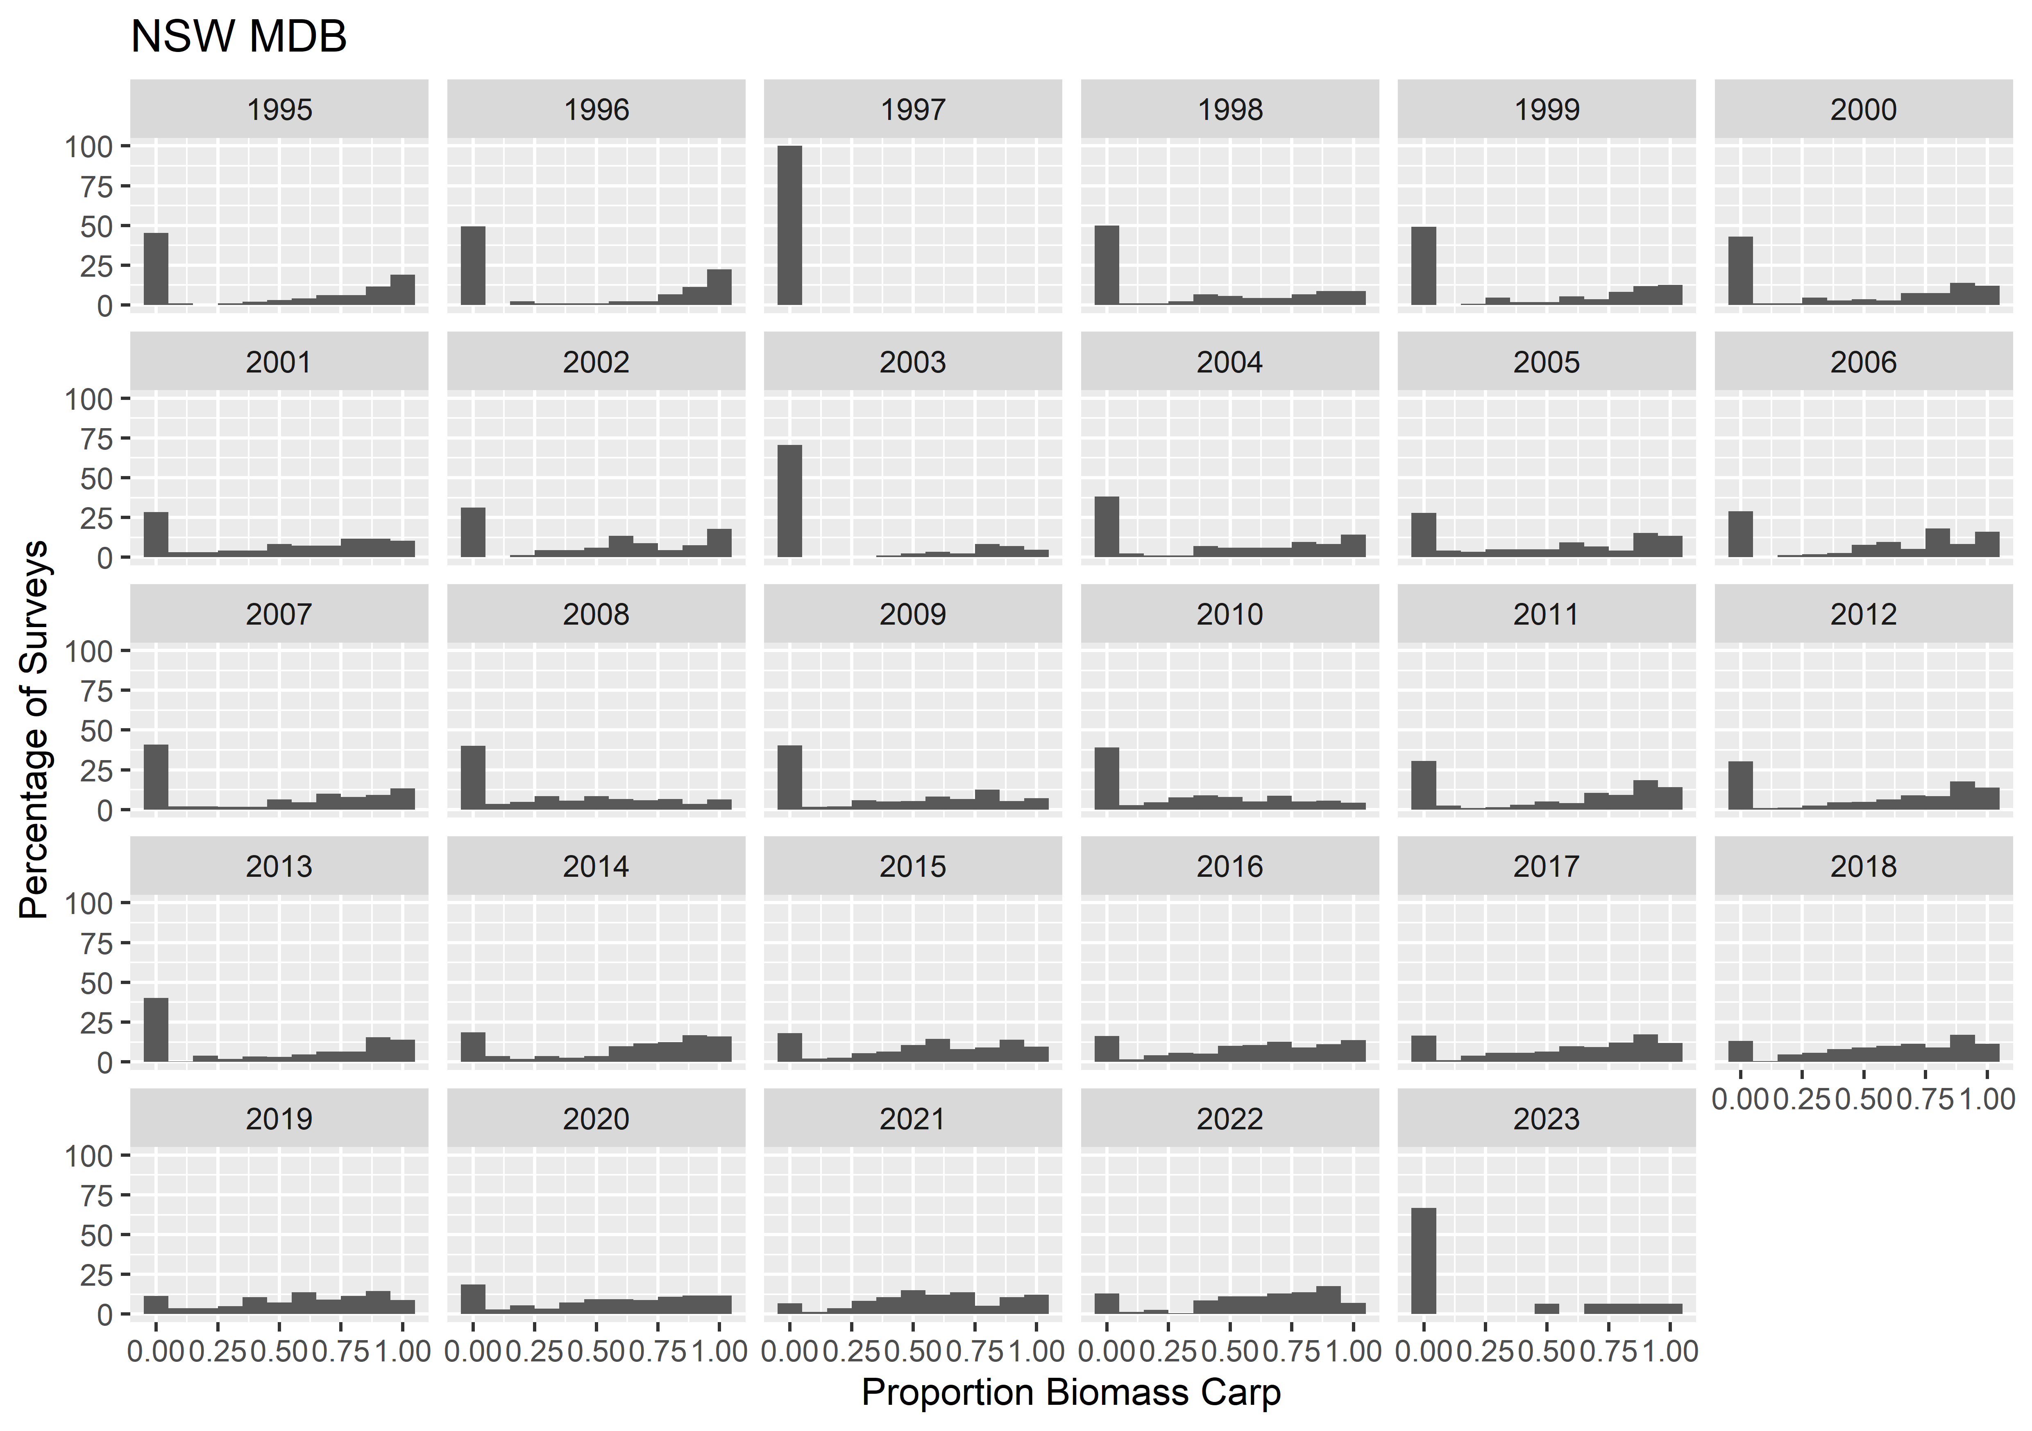

Slide 20
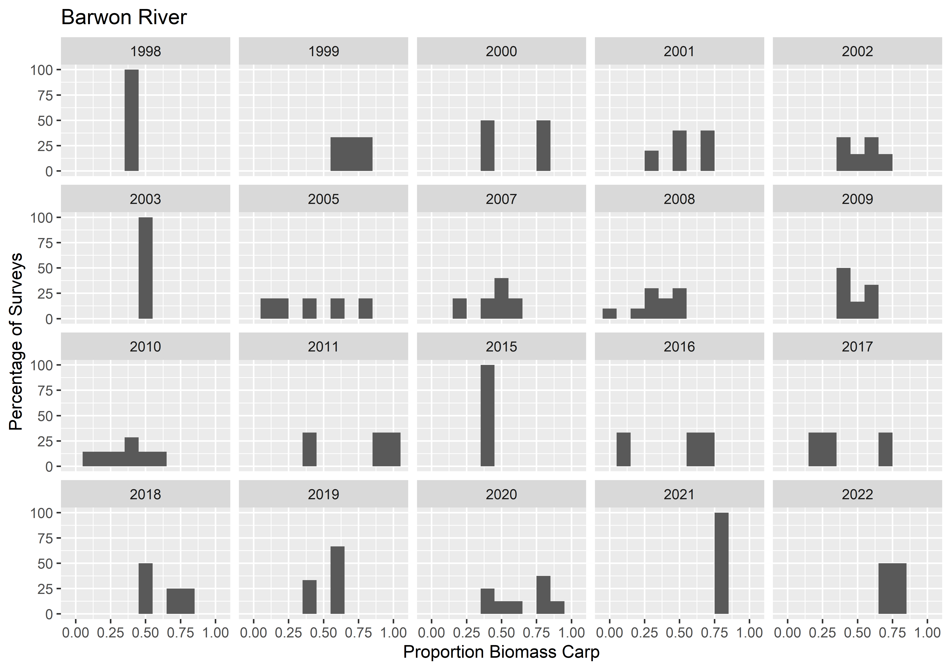

Slide 21
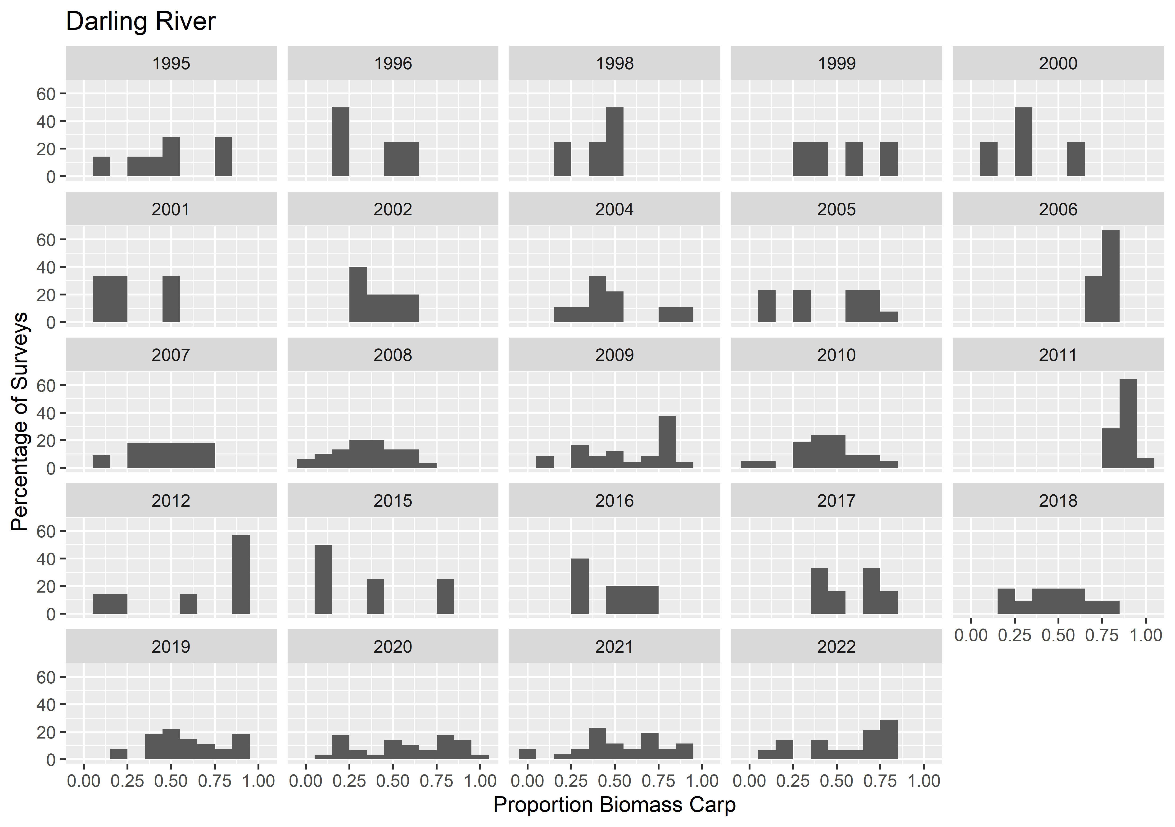

Slide 22
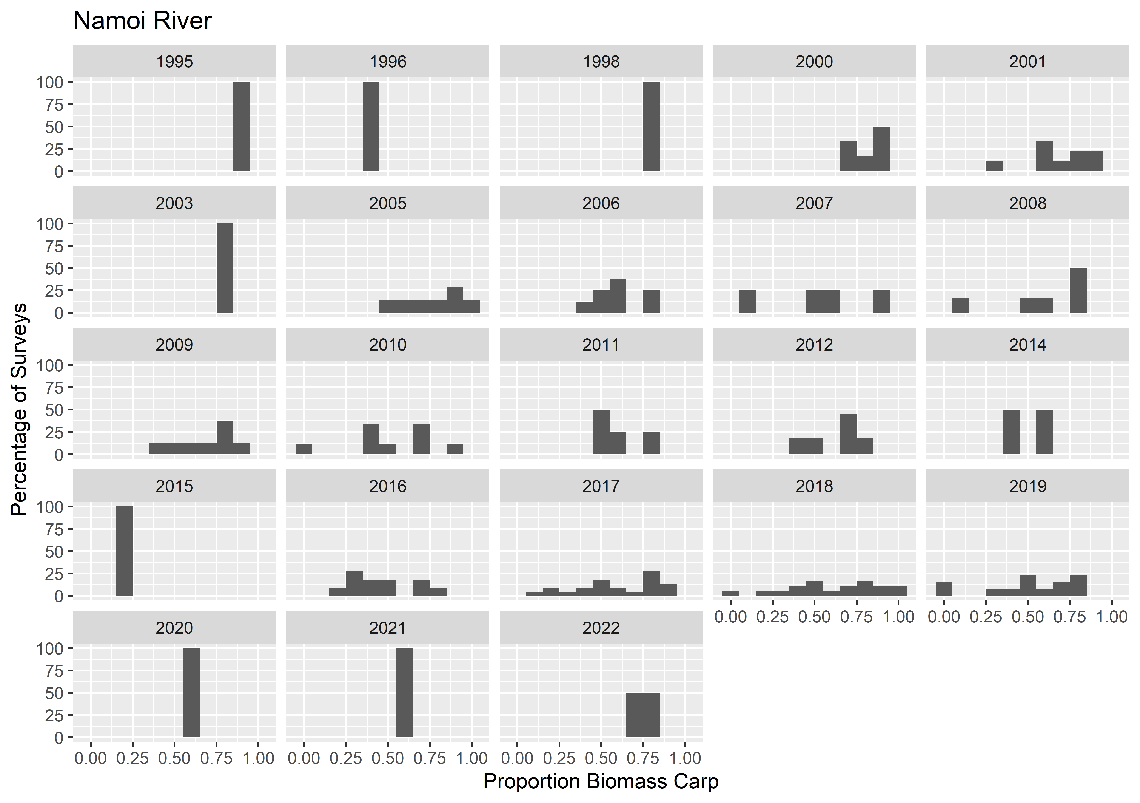

Slide 23
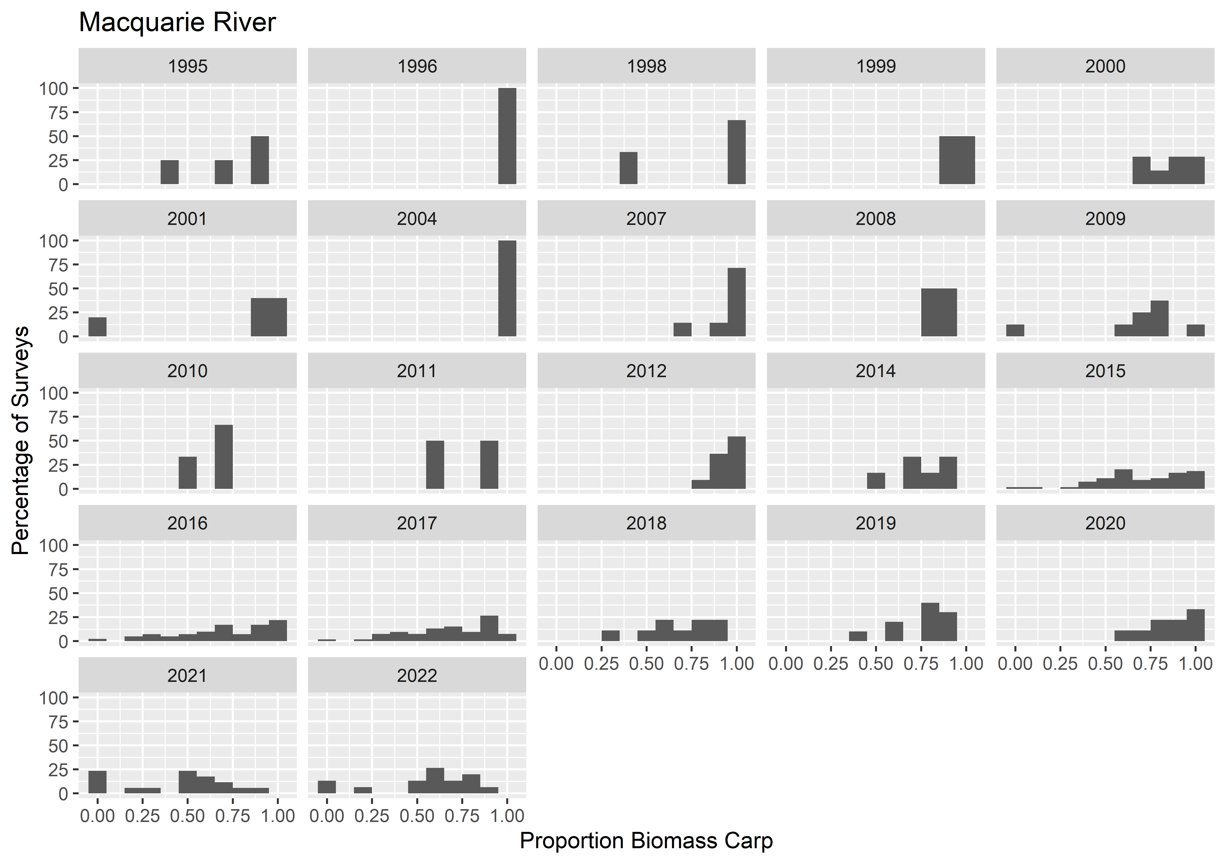

Slide 24
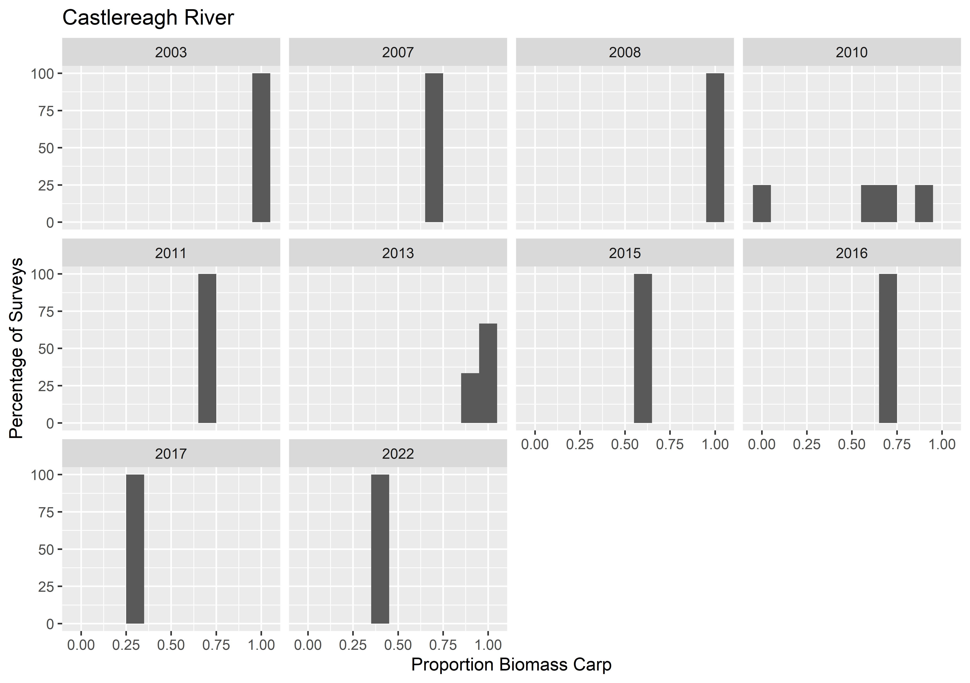

Slide 25
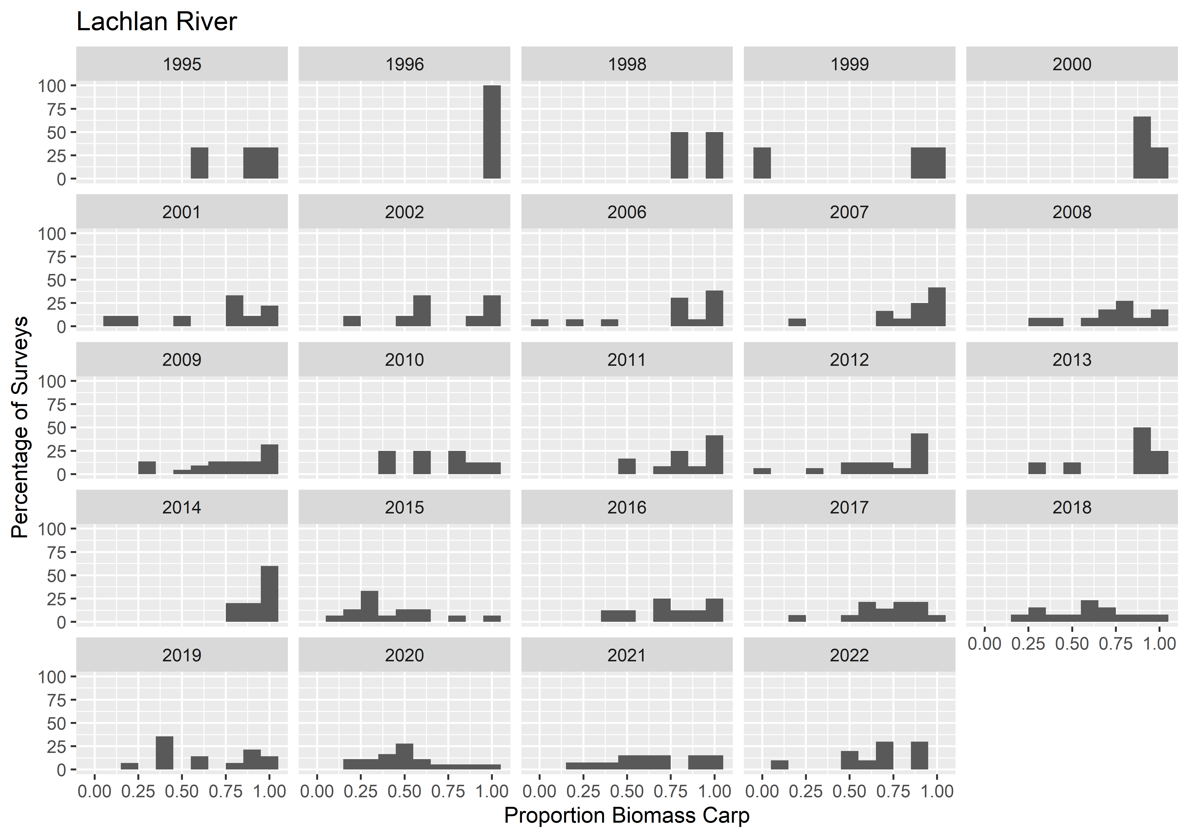

Slide 26
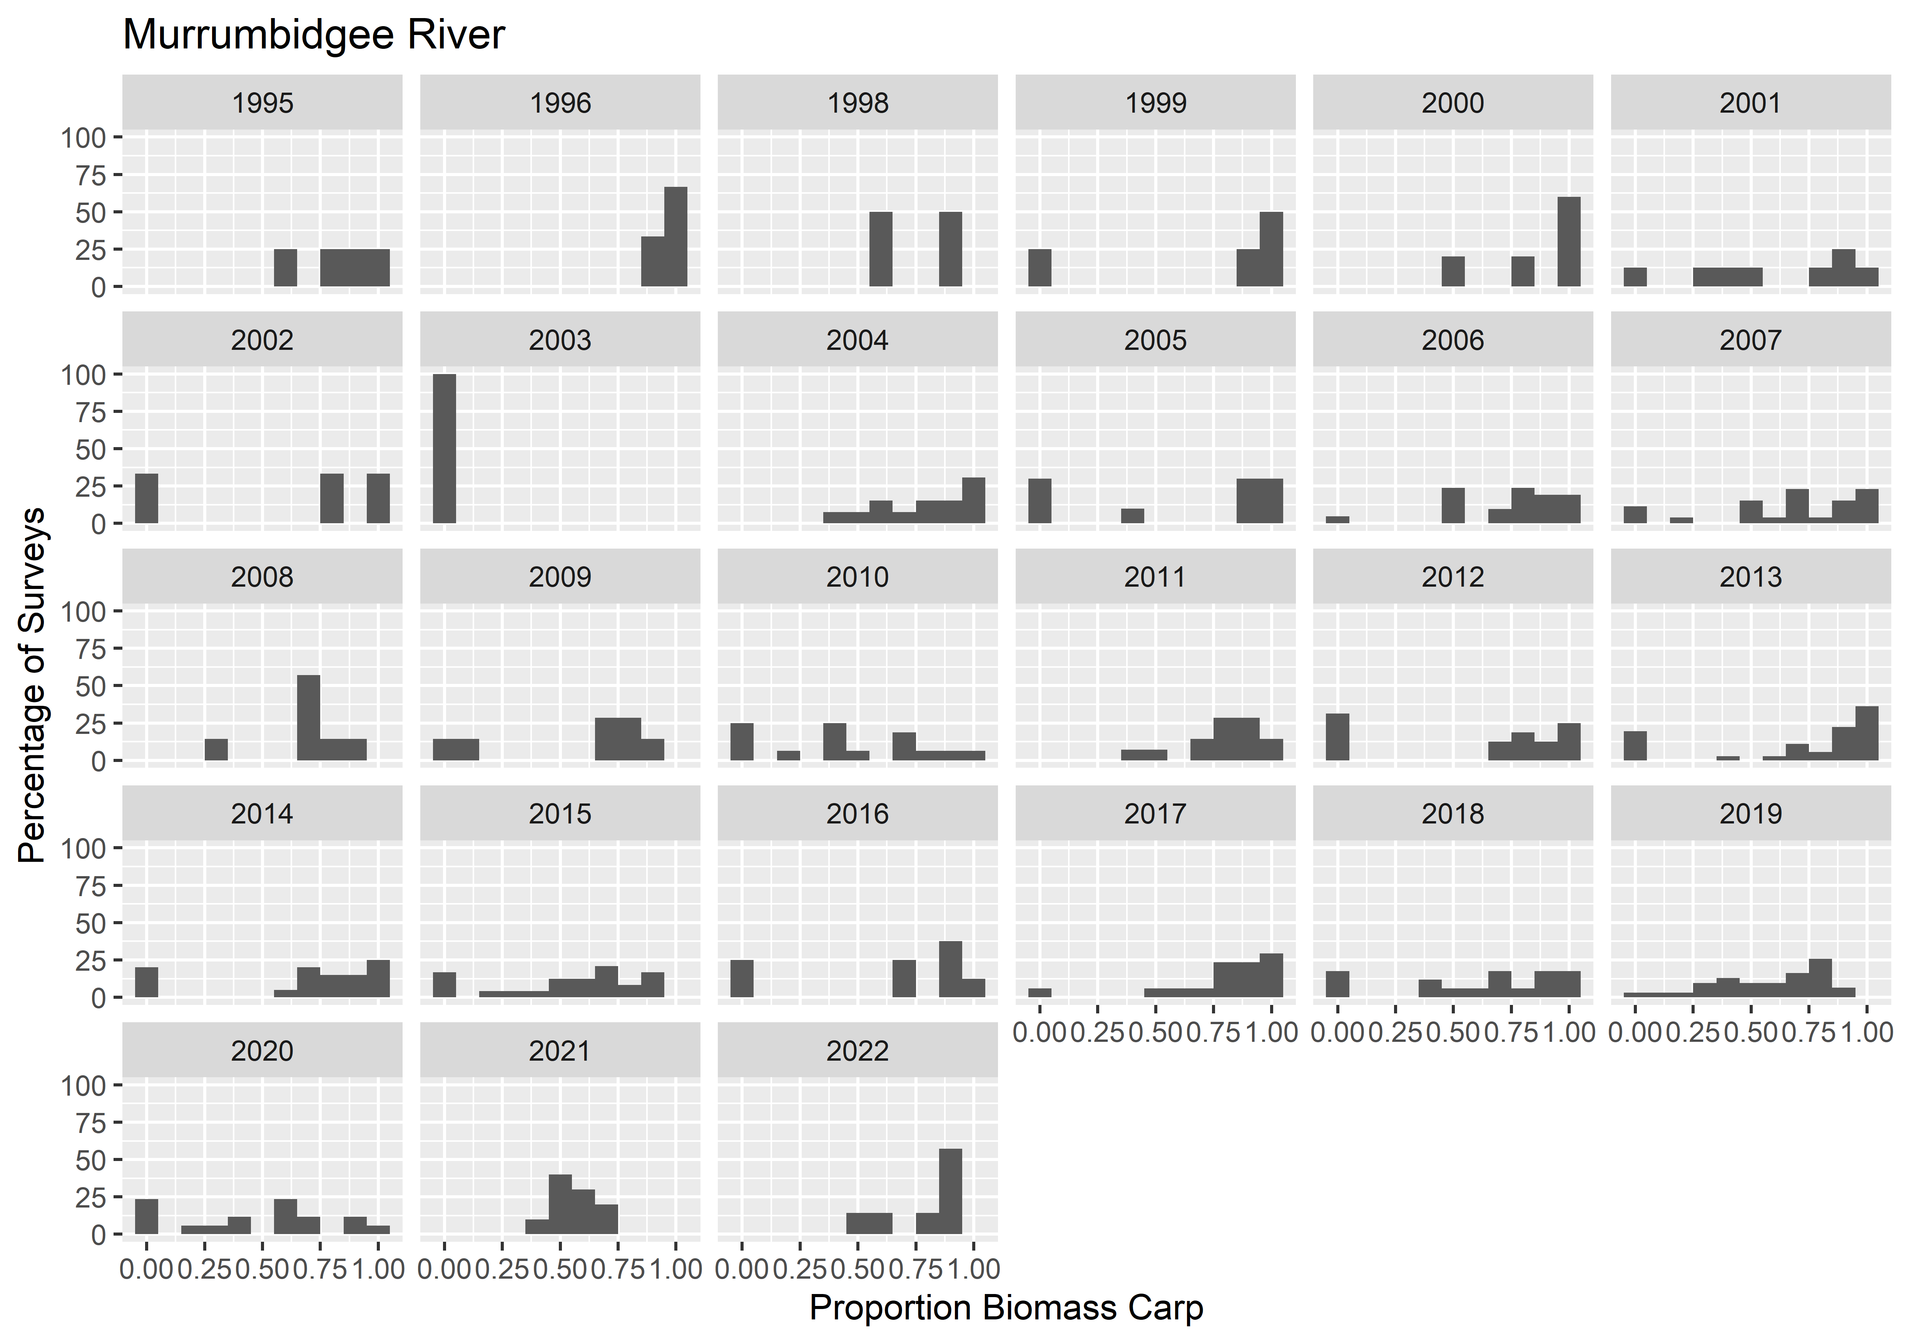

Slide 27
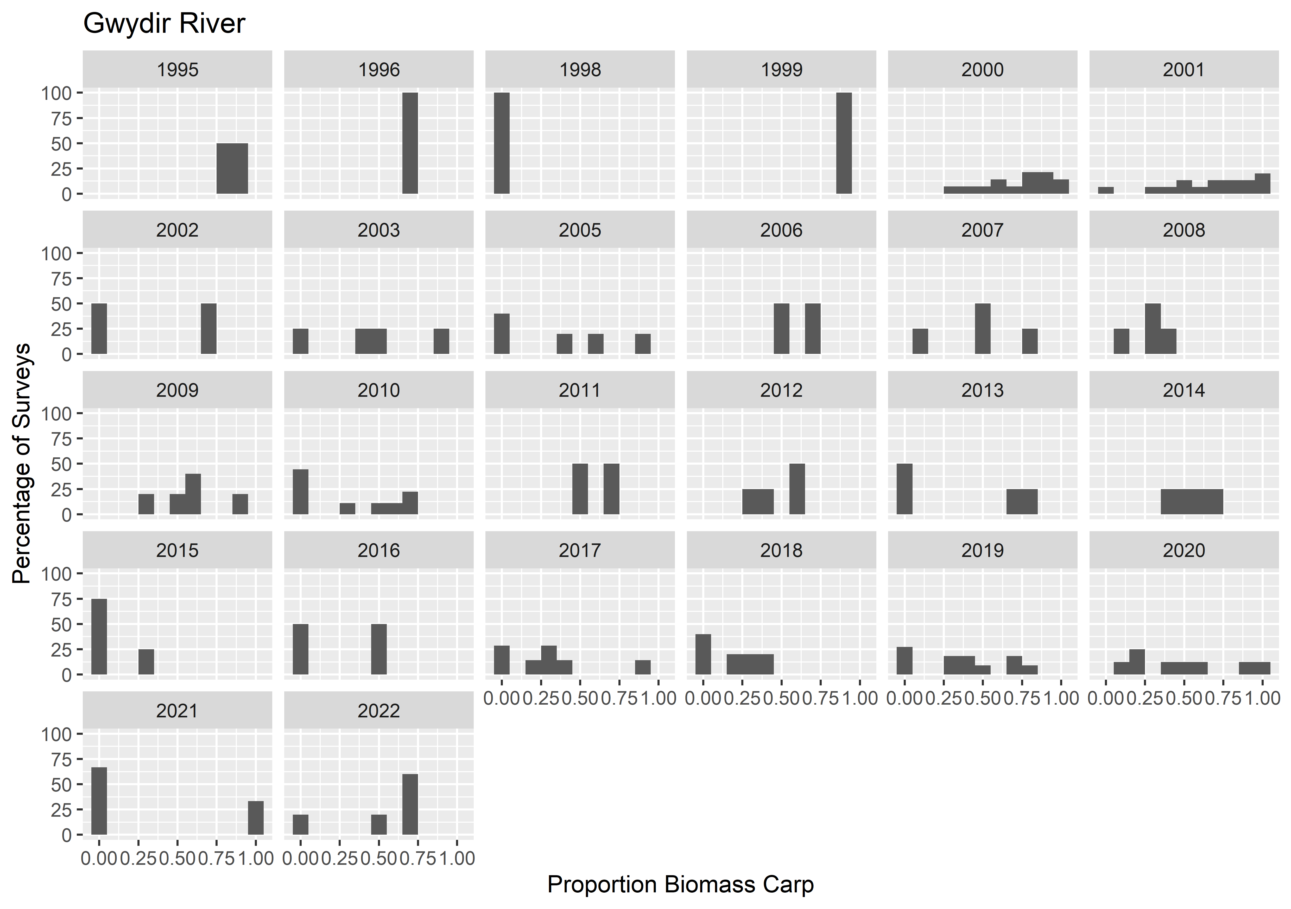

Slide 28
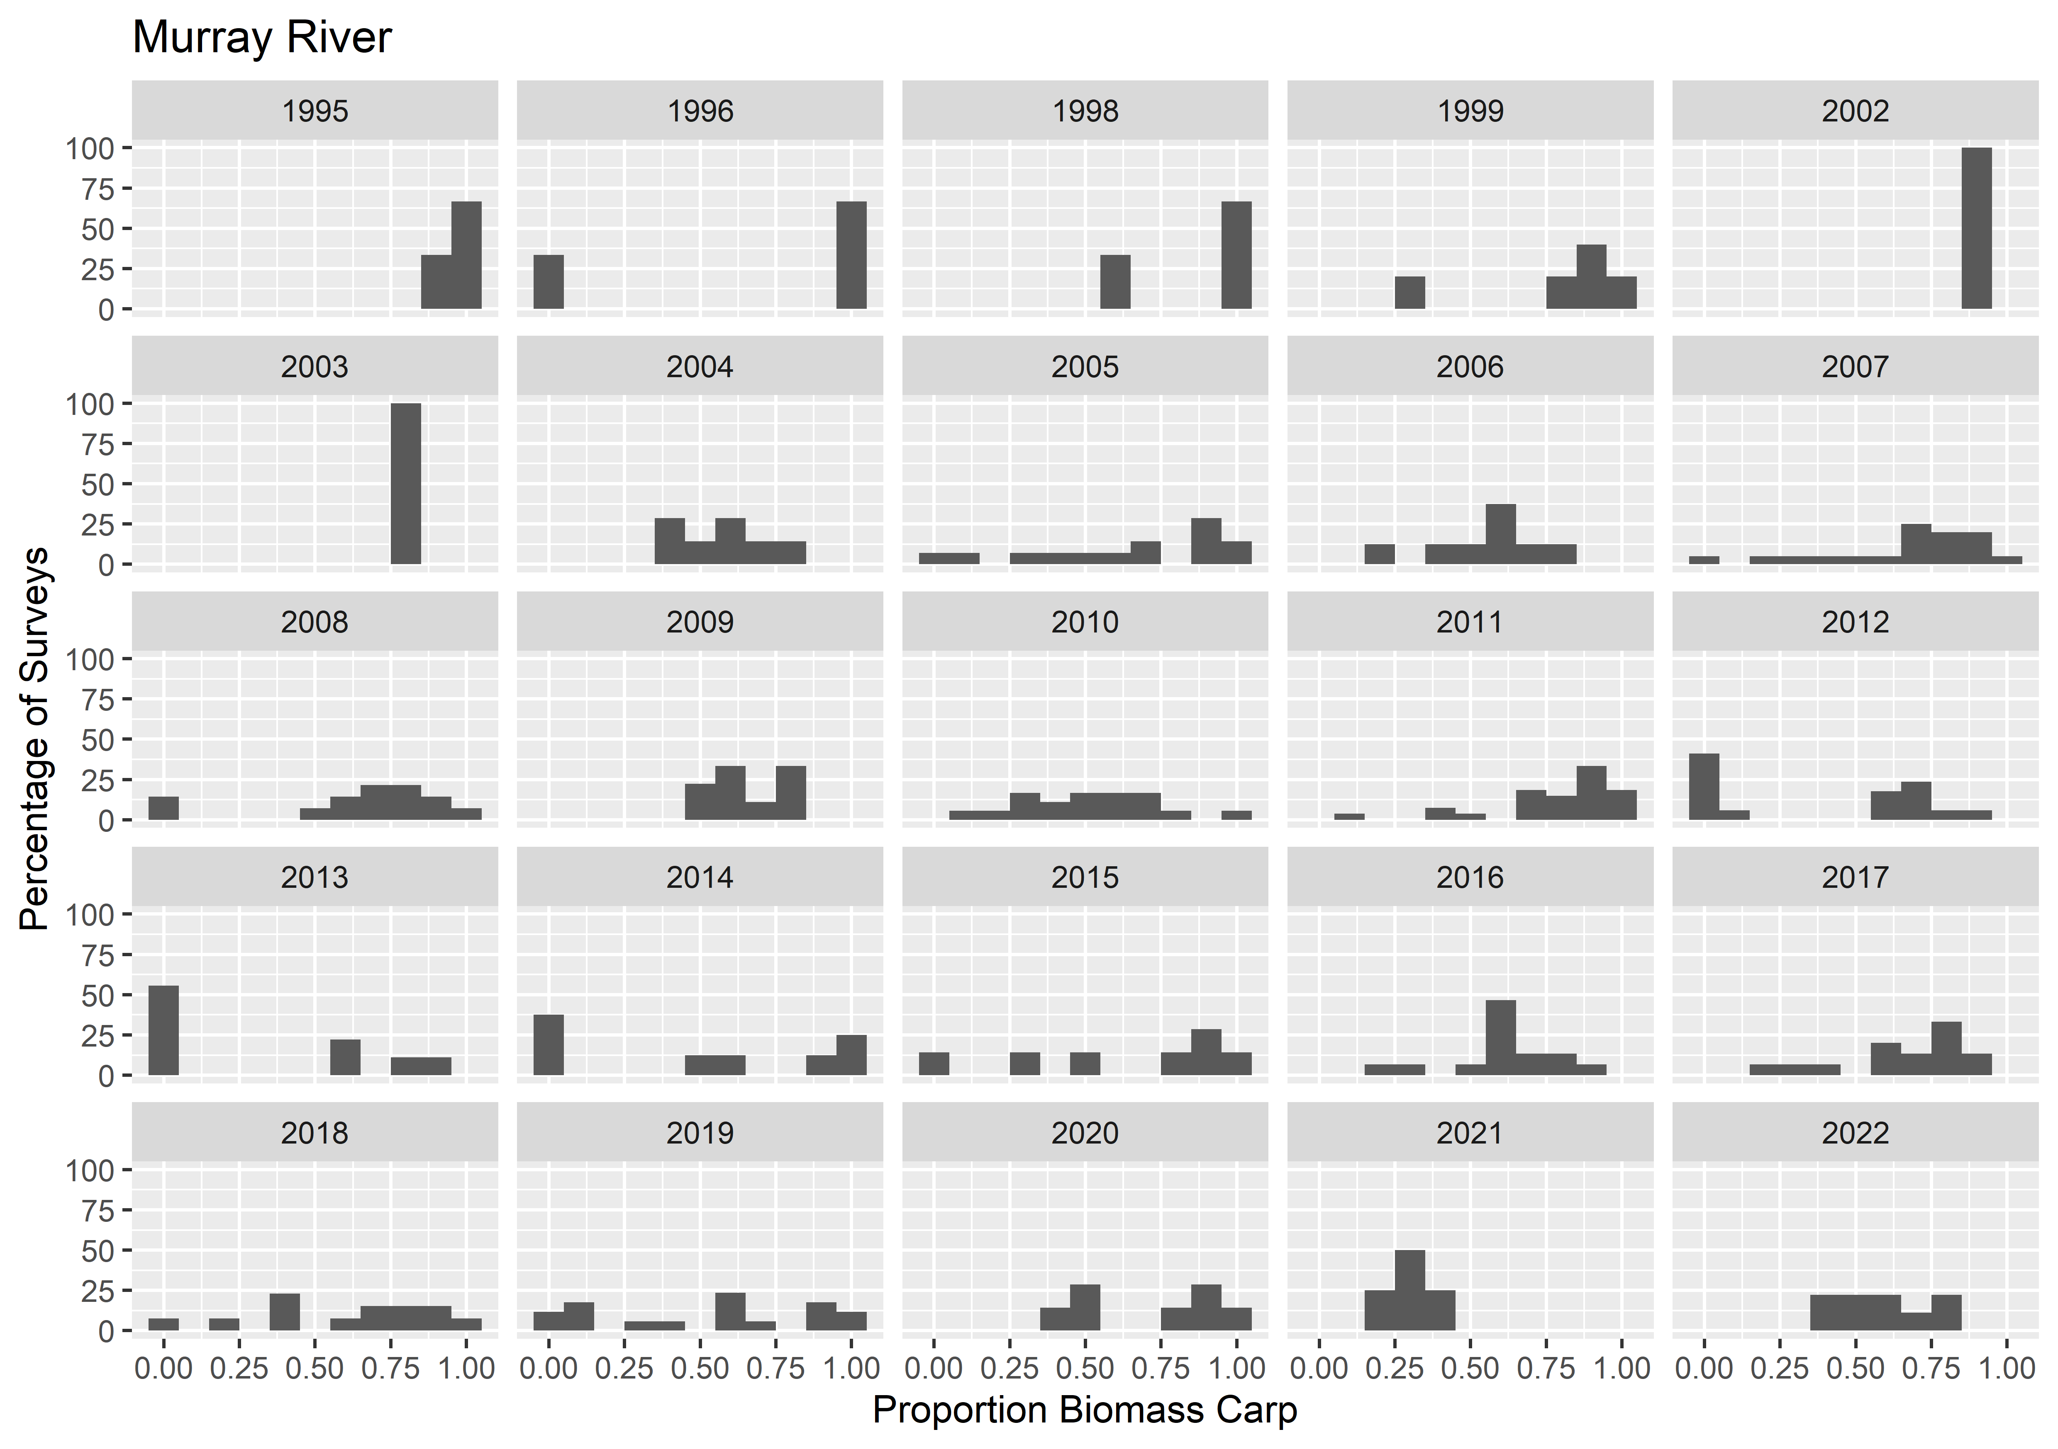

Slide 29
Raw data but at the shot level
Similar to above plots but harder to interpret due to the large number of shots that were only carp or had no carp (giving large proportions of zeros and ones)
Single example below but have others available if something thinks it’s useful (I do not)
Note some years differ from the previous plots when a single shot has large fish and therefore dominates sample biomass across shots

Slide 30
